Slide 1
Do you need a Dispatcher?
A critical look at command dispatchers and messaging frameworks in .NET

Slide 2




Introduction
The .NET ecosystem offers many command/messaging frameworks
Some OSS projects shifting toward commercial models
Developers ask:
Do we need these? Are we not making it overly complicated?
Should we build it ourselves?

Slide 3
Who Are You?
I am a polyglot coding architect with over 20 years of experience delivering solutions in government, healthcare, and finance and ecommerce. During that time I have worked for the DTI, Reuters, Sungard, Misys, Beazley, Huddle and Just Eat Takeaway delivering everything from bespoke enterprise solutions, 'shrink-wrapped' products for thousands of customers, to SaaS applications for hundreds of thousands of customers. I am an experienced systems architect with a strong knowledge of OO, TDD/BDD, DDD, EDA, CQRS/ES, REST, Messaging, Design Patterns, Architectural Styles, ATAM, and Agile Engineering Practices I am frequent contributor to OSS, and I am the owner of: https://github.com/BrighterCommand. I speak regularly at user groups and conferences around the world on architecture and software craftsmanship. I run public workshops teaching messaging, event-driven and reactive architectures. I have a strong background in C#. I spent years in the C++ trenches. I dabble in Go, Java, JavaScript and Python.
www.linkedin.com/in/ian-cooper-2b059b
Notes:
Walk through the agenda briefly. Let the audience know we'll get practical and example-driven.
Outline of the talk (sections as bullets):
DDD to RDD: What’s missing, and where RDD fits
Key ideas: responsibilities, roles, collaborations
THE EXAMPLE: Modeling with CRC cards in practice
RDD’s place in modern development: DDD, TDD, and agility

Slide 4


Slide 5
Agenda
Commands and Queries
Command Processor and Dispatcher
Message Pump
Commands vs. Events
Reactor vs. Proactor
Wrap-up

Slide 6
Commands and Queries

Slide 7
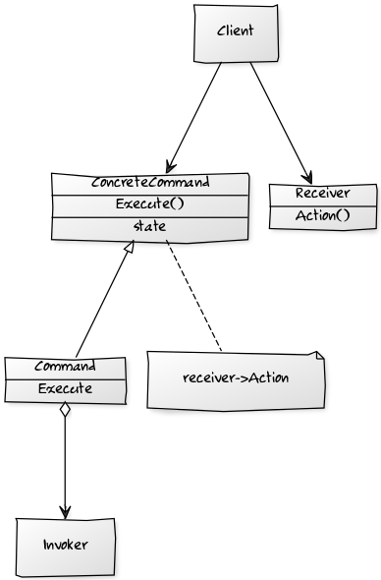
Command Design Pattern
Command - Declares an interface for executing an operation.
ConcreteCommand –Defines a binding between a Receiver object and an action. Implements Execute by invoking the corresponding operation(s) on the Receiver.
Client – creates a ConcreteCommand object and sets its Receiver.
Invoker - asks the Command to carry out the request.
Notes:
Represents an intent to change system state
- Encapsulates one use case
Named in imperative: `PlaceOrder`, `CancelSubscription`
public record PlaceOrderCommand(Guid OrderId, string ProductId, int Quantity);

Slide 8
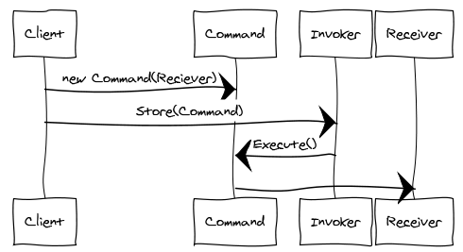
An Invoker object knows about the concrete Command object.
The Invoker issues a request by calling Execute on the Command.
When commands are un-doable, the Command stores state for undoing the command prior to invoking Execute.
The Command object invokes operations on its Receiver to carry out the request
Notes:
he command design pattern encapsulates a request as an object, allowing reuse, queuing or logging of requests, or undoable operations.
It also serves to decouple the implementation of the request from the requestor. The caller of a command object does not need to understand how the command is actioned, only that the command exists.
When the caller and the implementer are decoupled it becomes easy to replace or refactor the implementation of the request, without impacting the caller - our system is more modifiable.
Our ability to test the command in isolation of the caller - allows us to test our behaviour without mocking a framework - we can instantiate the command, provide 'fake' parameters to it and confirm the results.
We can also re-use the command from multiple callers.
An Invoker object knows about the concrete Command object.
The Invoker issues a request by calling Execute on the Command.
When commands are un-doable, the Command stores state for undoing the command prior to invoking Execute.
The Command object invokes operations on its Receiver to carry out the request

Slide 9
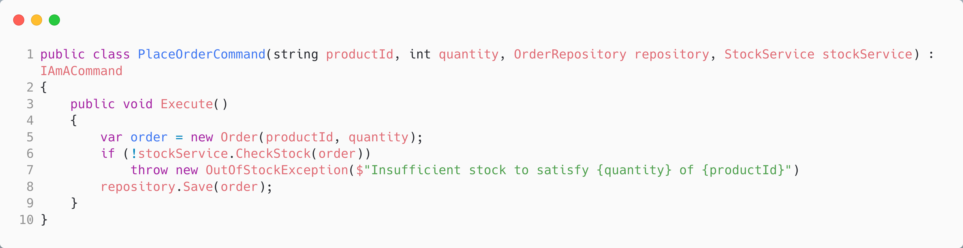
We could use interfaces over concrete dependencies if we wanted to use in-memory or fakes, as needed (in-memory for slow I/O for example)
Here, the interface indicates the role, a stereotype, that this object plays
Demo code is often ‘simple CRUD’ and as such is often a more questionable ‘fit’ for usage of the command pattern than real domains.

Slide 10
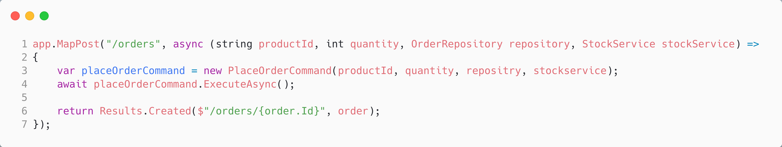

Slide 11
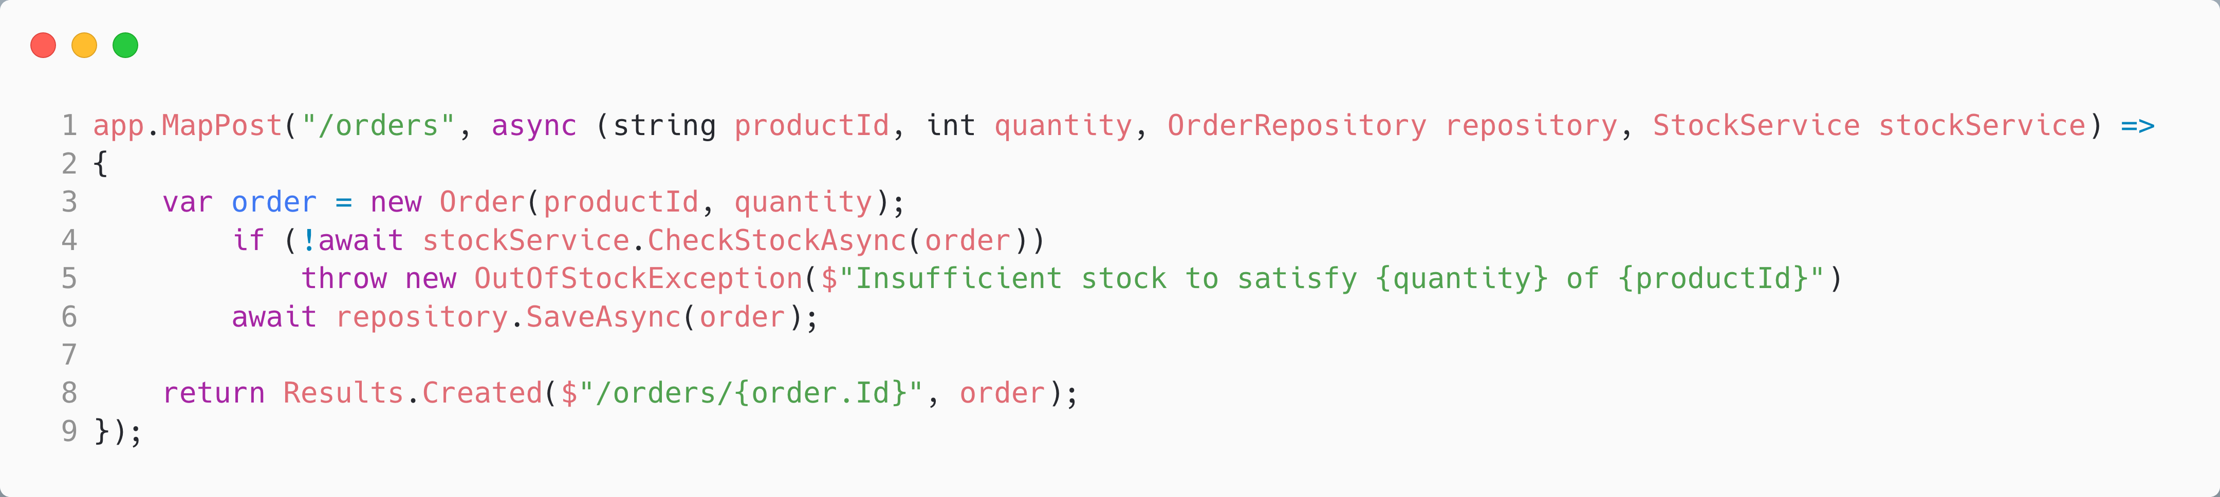
Why Not Just Inline the Code?
Notes:
- Web controller can call domain logic directly
- But…
- Hidden business use cases
- Harder to test
- Cross-cutting concerns bleed into controllers

Slide 12
Command Pattern Benefits
Separation of Concerns: decouple the implementation of the request from the requestor – allows modification, even replacement, of one without the other.
Use Case: A command has an affinity to a use case. As such, it allows us to encapsulate a use case within our domain model,
Test Isolation: allows us to test our behaviour without mocking a framework - we can instantiate the command, provide parameters to it, and confirm the results.
Quality: the command can encapsulate the details of orthogonal concerns like observability, resilience (retry/circuit breaker), or compensating actions.
Ports & Adapters: allows us to implement a ports-and-adapters architecture. Commands act as ports that can be invoked from driven adapters or invoked as driving adapters.
Notes:
- Separation of concerns
- Easier testing and mocking
Enables centralized policy enforcement
The command design pattern encapsulates a request as an object, allowing reuse, queuing or logging of requests, or undoable operations.
It also serves to decouple the implementation of the request from the requestor. The caller of a command object does not need to understand how the command is actioned, only that the command exists.
When the caller and the implementer are decoupled it becomes easy to replace or refactor the implementation of the request, without impacting the caller - our system is more modifiable.
Our ability to test the command in isolation of the caller - allows us to test our behaviour without mocking a framework - we can instantiate the command, provide 'fake' parameters to it and confirm the results.
We can also re-use the command from multiple callers.

Slide 13
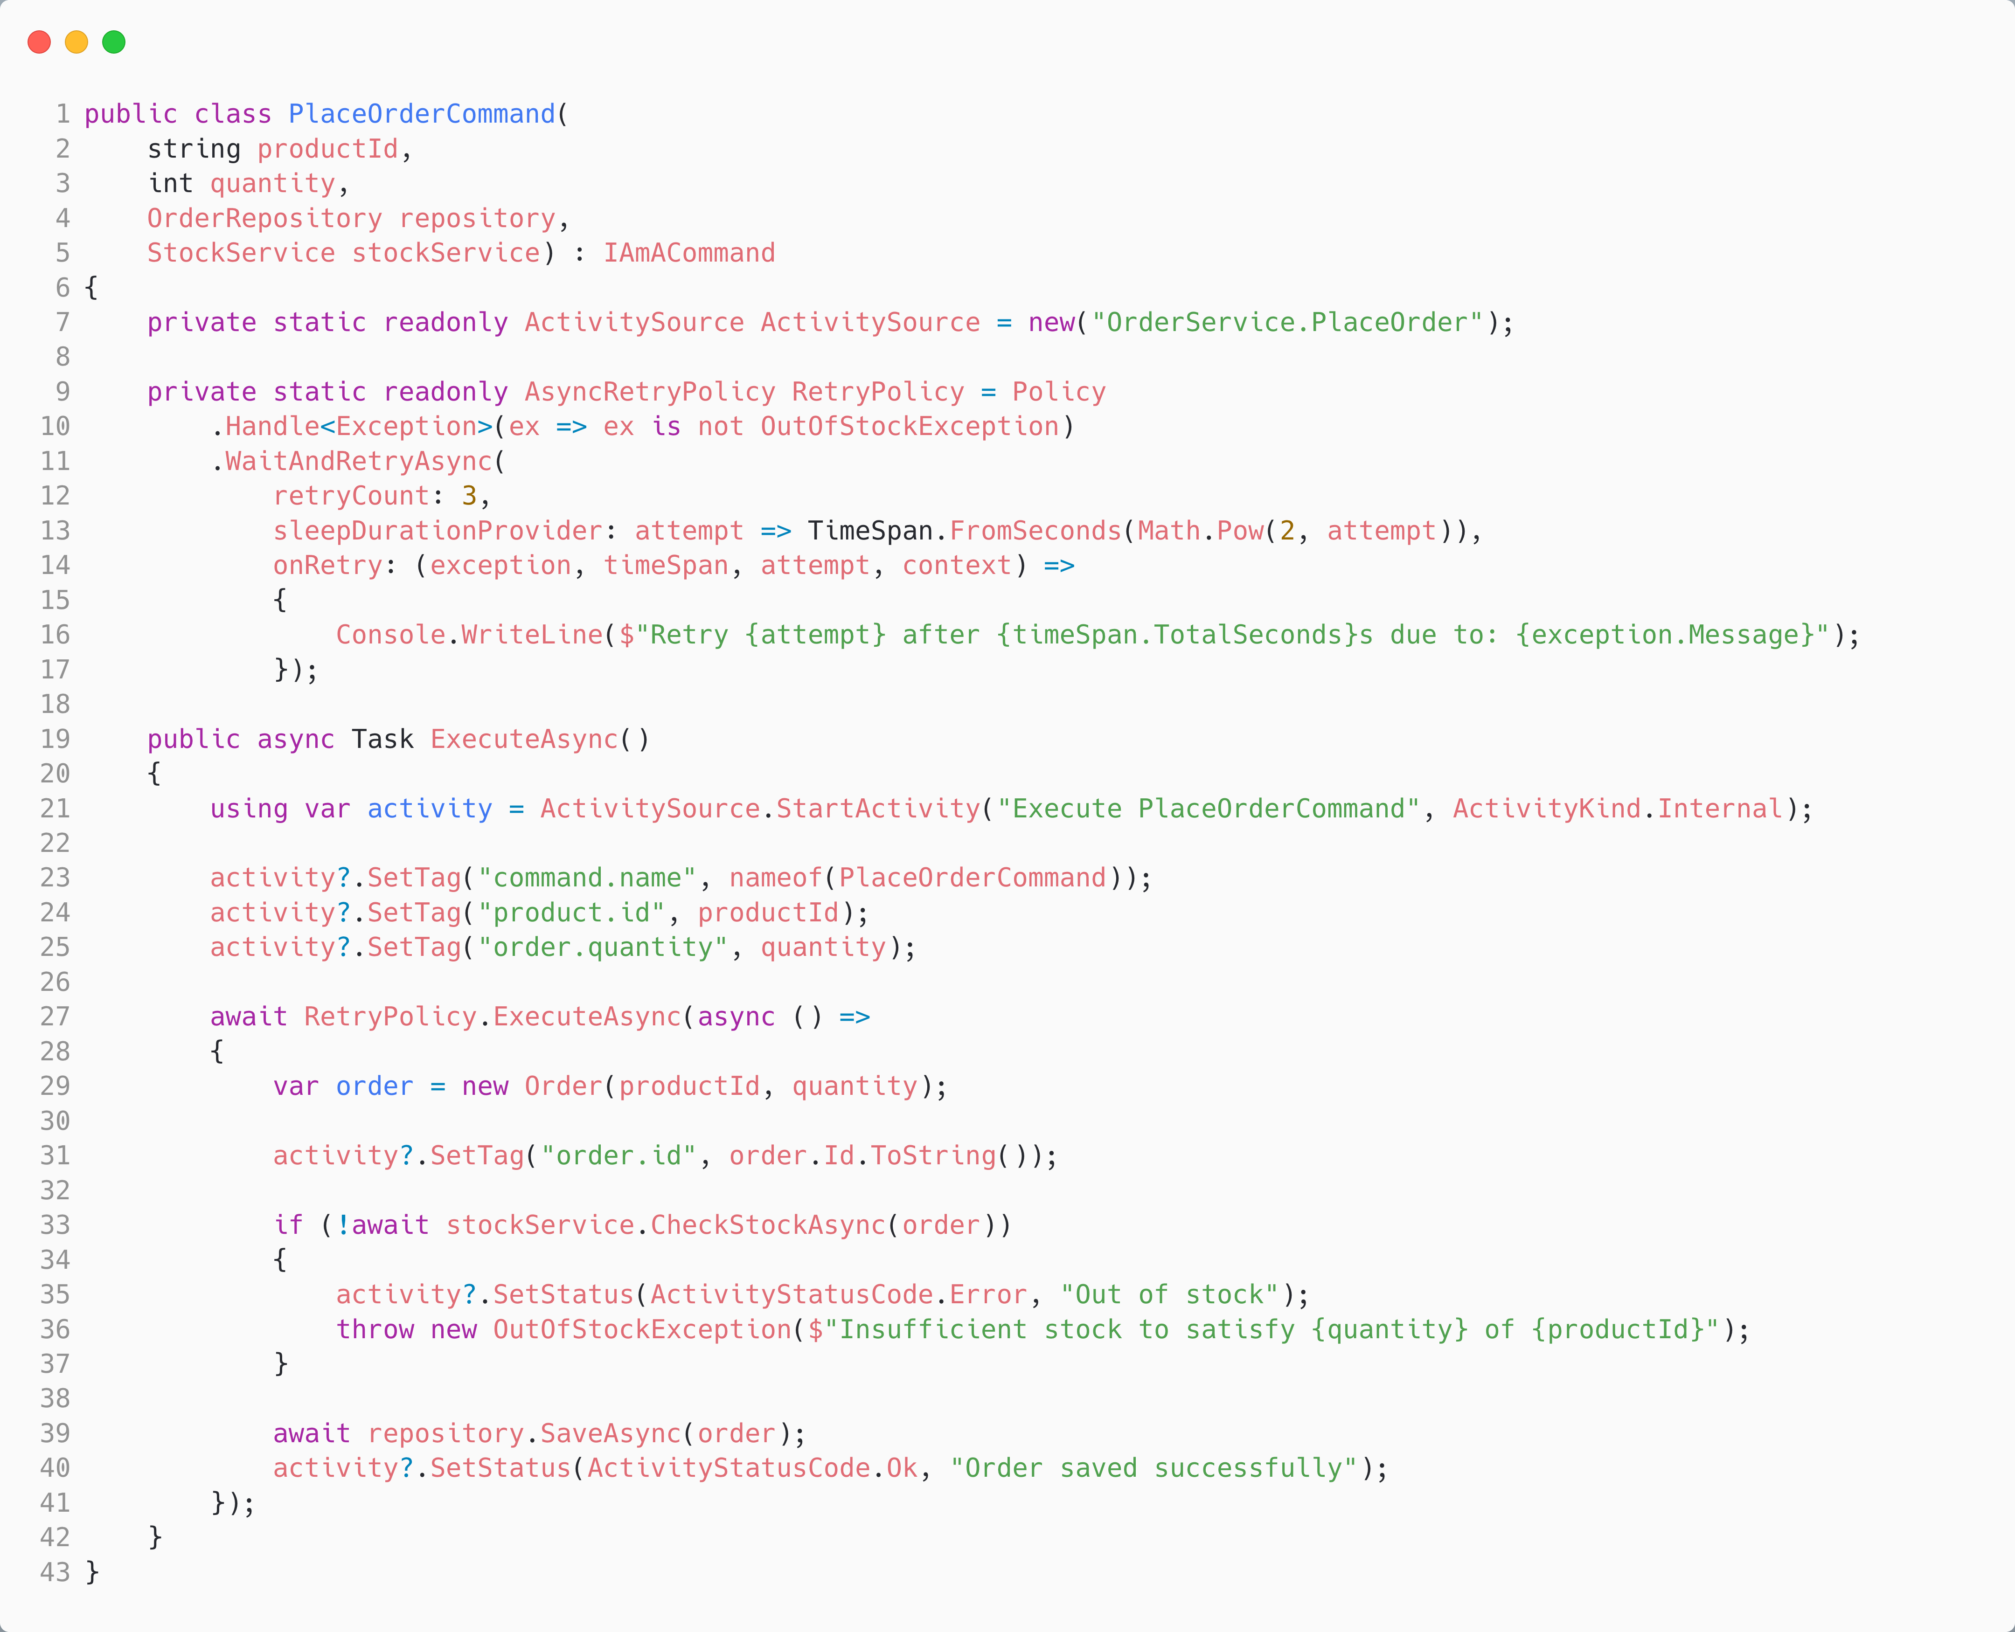
Trivial examples, arguing for not using a command pattern, often miss the complexity of robust, resilient code, that we can encapsulate in the command.

Slide 14
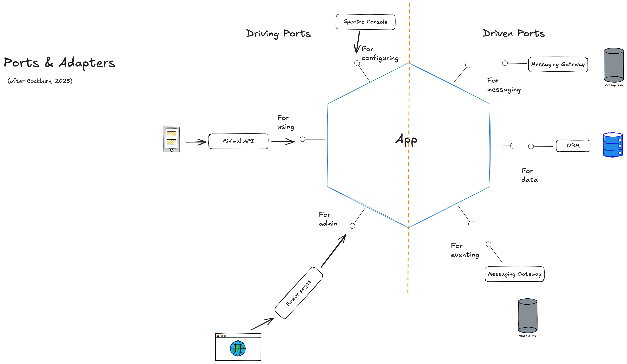
The provided interface may be a command which represents a use case
xunit
Tests may exercise those commands
Notes:
There are many benefits to the Ports & Adapters, AKA Hexagonal Architecture, code structure.
Testing: You can write and run system-level tests without production connections, making them purer and faster.
Testing again: You can swap out the production connections for test connections, and vice versa—for any of the connections, input or output—without having to recompile your system.
Leakage protection: The test wall around your application will detect whenever someone leaks UI details or technology details into the business section, or business logic into the UI or external technology sections.
Large system separations: Different teams can develop their sections of code independently, test them separately, and connect them according to defined and tested interfaces.
Long-running systems: You can replace one external connection with another as technology and business needs change over years.
Domain-Driven Design: Once the technology elements are safely outside the application boundary, you are free to focus on the domain design without distraction.
Cockburn, Alistair; Garrido de Paz, Juan Manuel. Hexagonal Architecture Explained (p. 18). (Function). Kindle Edition.

Slide 15
Command Query Separation (CQS)
CQS: "Asking a question should not change the answer."
Commands: Do something, no return
Queries: Return data, no side effects
Where does the order come from?
Notes:
Why use CQS?
Because we want to cleanly separate betwen

Slide 16
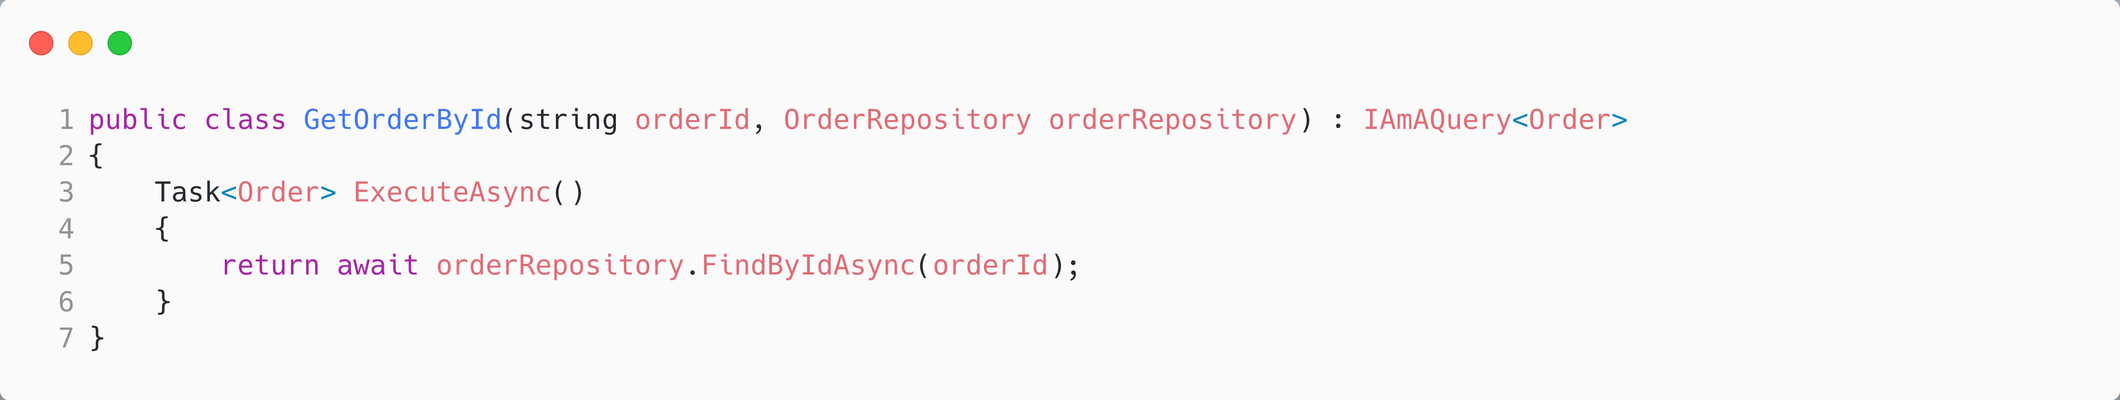
Queries as Commands (Almost)
The lack of side effects means that we can easily build caching into this query.
The main difference is that we are returning a value!
Notes:
public record GetOrderByIdQuery(Guid OrderId); public class GetOrderByIdHandler { public OrderDto Handle(GetOrderByIdQuery query) { return _db.Find<Order>(query.OrderId); } }

Slide 17
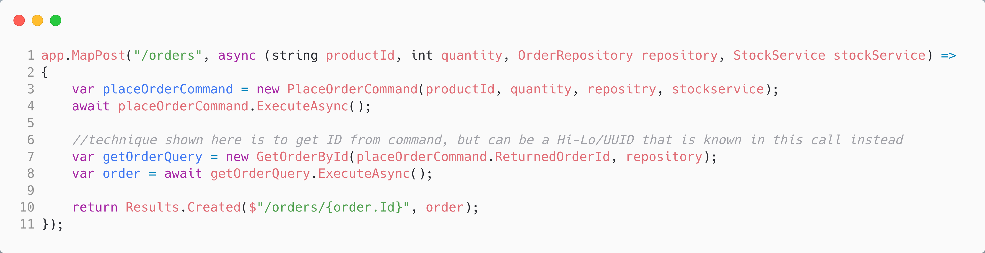
The most straightforward route is to **know** the order ID in the caller so that it can be passed to PlaceOrderCommand. However, using an **out** value on the command helps us avoid return types on the command, which would be necessary without it.

Slide 18
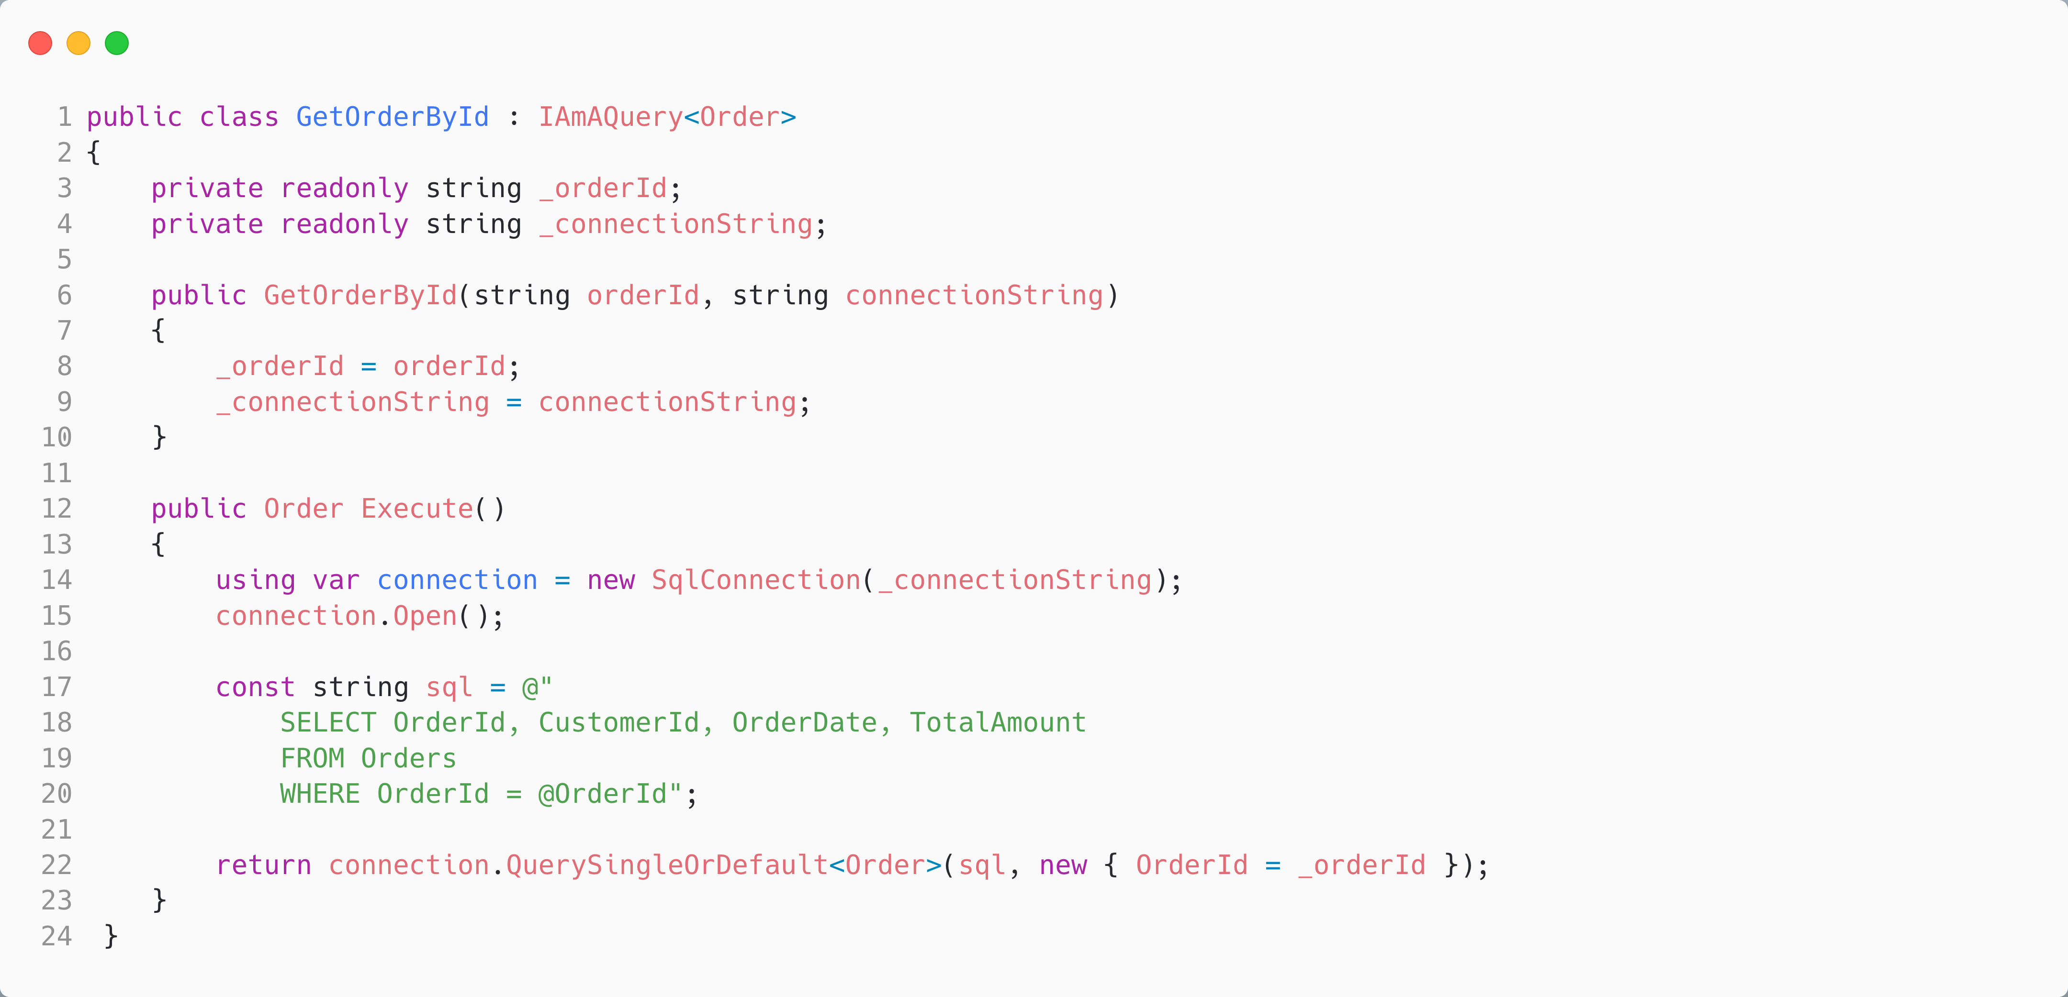
Command-Query Responsibility Separation
Instead of using the same model for commands and queries, we can often simplify by using direct queries (SQL in this case). This is particularly helpful at reducing the complexity of configuring ORM query engines

Slide 19
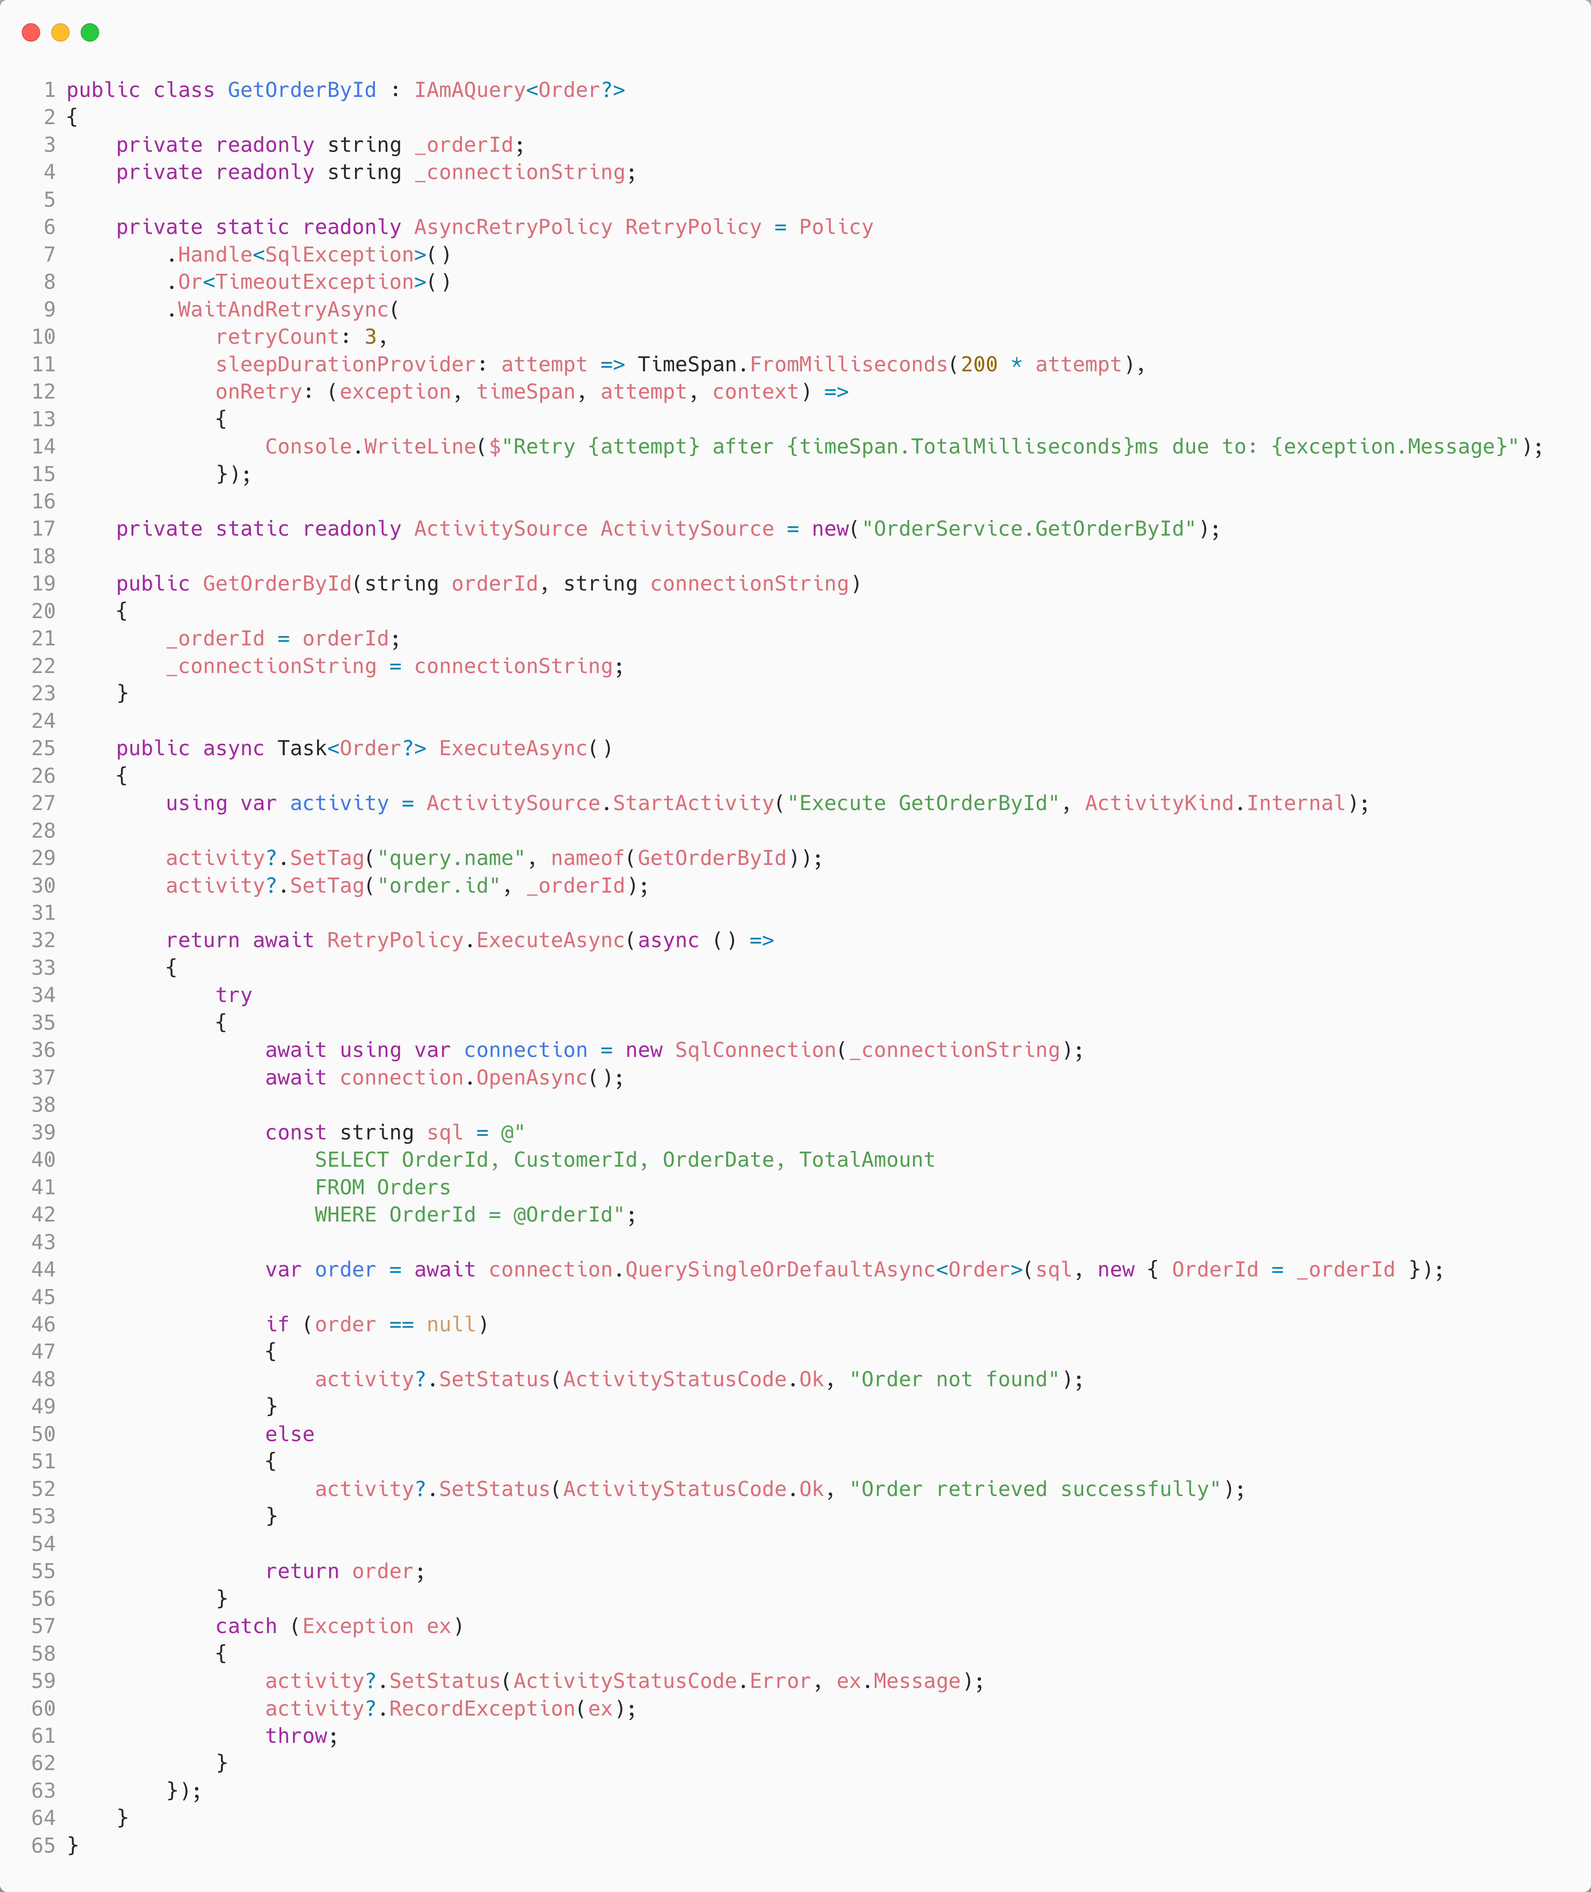
Remember, trivial examples, arguing for not using a Query pattern, often miss the complexity of robust, resilient code, that we can encapsulate in the query.
We don’t show all possibilities here, due to space constraints, but consider:
What would happen if we wanted to perform validation as the first step for a Command or Query? Valid product ID in a new order command, for example?
How about adding a caching layer? Or a fallback to the last query results for those parameters?
A minimal API endpoint clutters very quickly.

Slide 20
Why Use Commands and Queries?
Encapsulates a use case
Aligns well with Ports and Adapters as the “port”
Forms a transactional boundary
Allows re-use of use cases
Reduces Minimal API clutter
Encapsulates orthogonal concerns like resilience and observability
Separation of concerns: modification and replacement are easier.
Allows us to reduce the cognitive load – what fits in our head.
Enables Command Query Responsibility Separation

Slide 21
Although we have de-cluttered our minimal API, arguably we have only done so by the expedient of moving the clutter into our command? So have we really just “swept the problem under the rug?’

Slide 22
Command Processor and Dispatcher

Slide 23
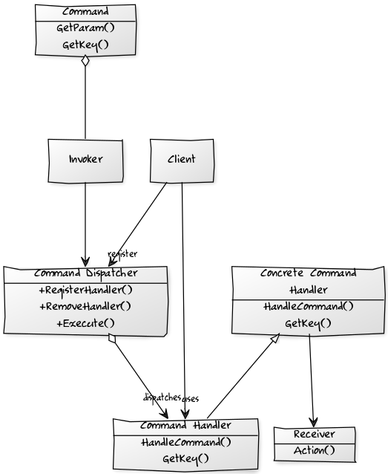
What is a Command Dispatcher?
Invoker - has a lit of Commands that are to be executed
Command - represents the request to be processed, encapsulating the parameters to be passed to the command-handler to perform the request
Command Handler - specifies the interface that any command handler must implement
Concrete Command Handler – implements the request
Command Dispatcher – Allows dynamic registration of Command Handlers and looks up handlers for commands, by matching command and handler key.
Client – registers Commands with the Command Dispatcher.
Notes:
- Routes command → handler
- Decouples senders from receivers
_dispatcher.Register<PlaceOrderCommand, PlaceOrderHandler>(); _dispatcher.Send(new PlaceOrderCommand(...));
Invoker - has a lit of Commands that are to be executed
Command - represents the request to be processed, encapsulating the parameters to be passed to the command-handler to perform the request
Command Handler - specifies the interface that any command handler must implement
Concrete Command Handler – implements the request
Command Dispatcher – Allows dynamic registration of Command Handlers and looks up handlers for commands, by matching command and handler key.
Client – registers Commands with the Command Dispatcher.

Slide 24
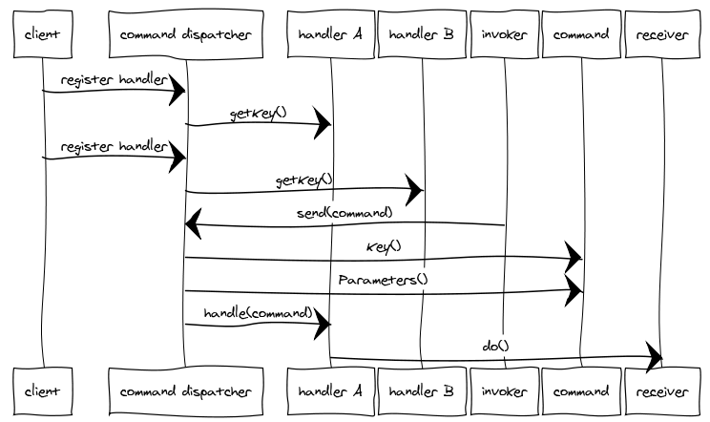
Command Dispatcher
We want to separate the Action-Request—the action we want to perform—along with the parameters, from the Action-Handler, which knows how to perform that action
A Command Dispatcher is an object that links the Action-Request with the appropriate Action-Handler.
We may distinguish between a Command Action-Request that has one Action Handler and an Event Action-Request that has many
Notes:
We want to separate an Action-Request object that contains the identity of the action we want to perform, along with the parameters for that action, from the Action-Handler, which knows how to perform that action.
A Command Dispatcher is an object that links the Action-Request with the appropriate Action-Handler.
We may distinguish between a Command Action-Request that has one Action Handler and an Event Action-Request that has many

Slide 25
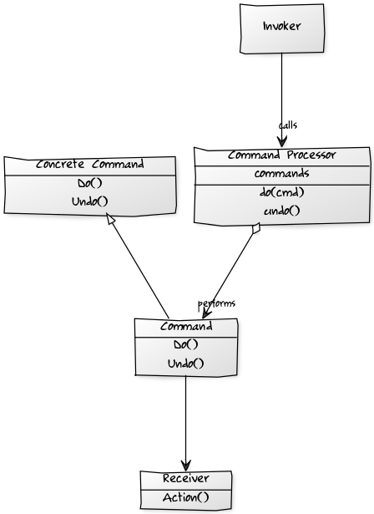
What is a Command Processor?
The Command Processor pattern separates the request for a service from its execution
A Command Processor component manages requests as separate objects, schedules their execution, and provides additional services such as storing request objects for later undo.
A Command Dispatcher and a Command Processor are similar in that both divorce the caller of a Command from the invoker of that Command.
However, the motivation is different. A Dispatcher seeks to decouple the caller from the invoker, allowing us to extend the system without modification to the caller.
Conversely, the motivation behind a Command Processor is to allow us to implement orthogonal operations such as logging or scheduling without forcing the sender or receiver to be aware of them. It does this by giving those responsibilities to the invoker.
Notes:
- Coordinates execution of commands
- May include:
- Retry
- Timeout
- Circuit breakers
Tracing/logging
The Command Processor pattern separates the request for a service from its execution.
A Command Processor component manages requests as separate objects, schedules their execution, and provides additional services such as the storing of request objects for later undo.
A Command Dispatcher and a Command Processor are similar in that both divorce the caller of a Command from invoker of that Command.
However, the motivation is different. A Dispatcher seeks to decouple the caller from the invoker to allow us to easily extend the system without modification to the caller.
Conversely the motivation behind a Command Processor is to allows us to implement orthogonal operations such as logging, or scheduling without forcing the sender or receiver to be aware of them. It does this by giving those responsibilities to the invoker.

Slide 26
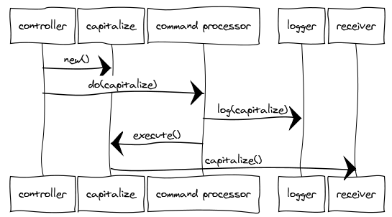
Command Processor
The Command Processor accepts requests for Commands, schedules and executes them, and performs any other orthogonal housekeeping operations.
A Command Processor forms a juncture at which concerns like retry, timeout, and circuit breaker can be implemented for all commands.
A Command Processor enforces quality of service and maximizes throughput.
Notes:
The Command Processor pattern provides details of how to manage a set of commands used to separate the request for service from its execution.
The Command Processor accepts requests for Commands, schedules and executes them, manages their history (such as storing for later undo or replay) and performs any other orthogonal housekeeping operations. The client is decoupled from the responsibilities of managing and scheduling commands.
A Command Processor enforces quality of service and maximizes throughput.
A Command Processor forms a juncture at which concerns like: retry, timeout and circuit breaker can be implemented for all commands.

Slide 27
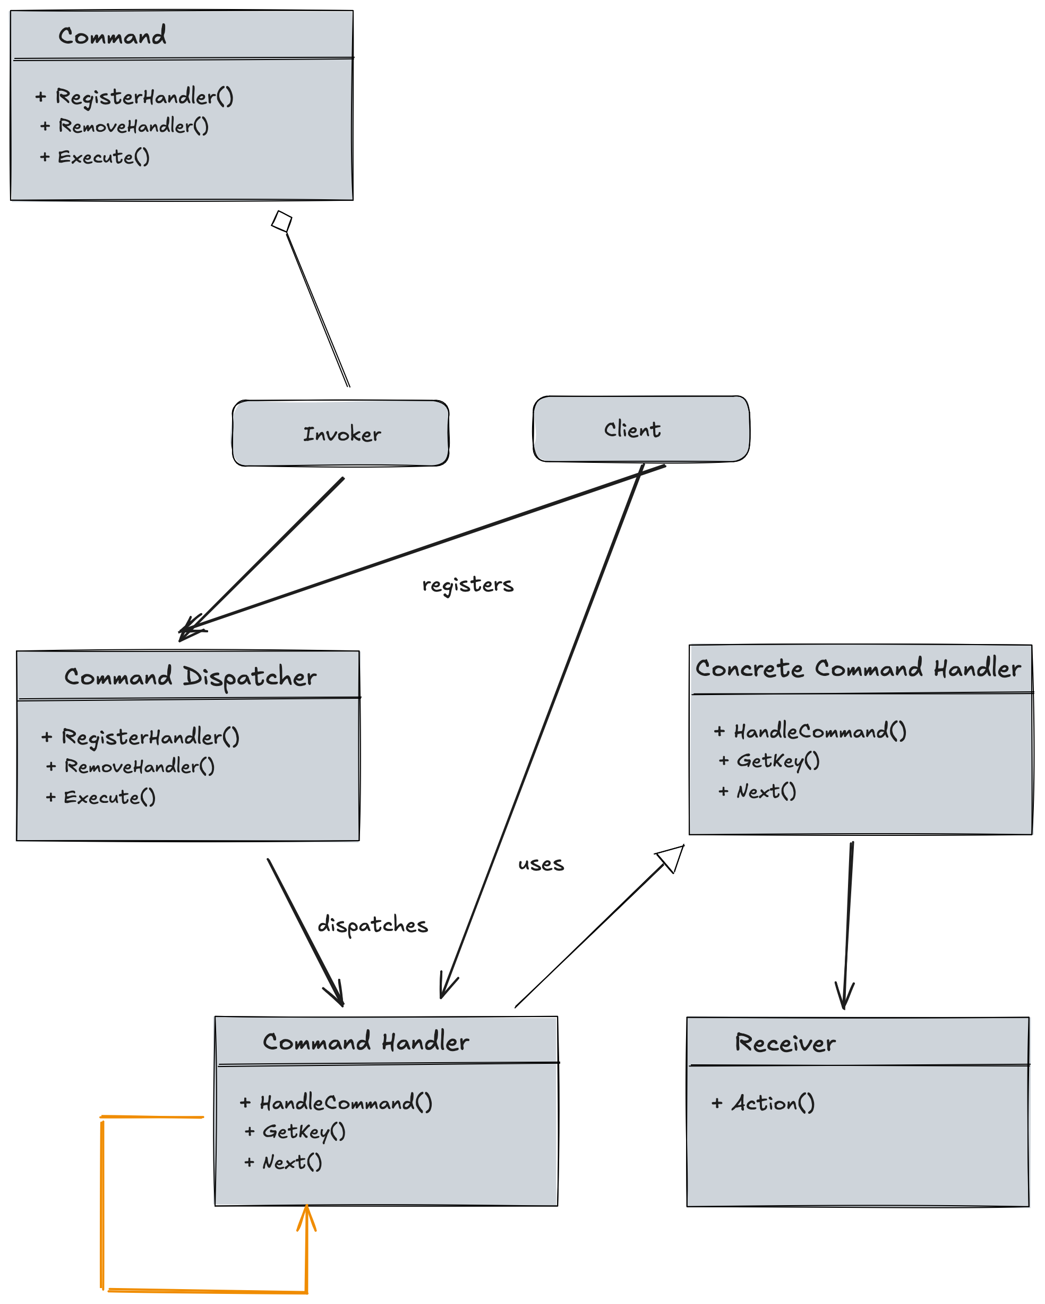
Processor: Dispatcher + Middleware Pipeline
To handle orthogonal concerns, we employ a pipes-and-filters architecture—orthogonal concerns run before the sink which has app logic.
This approach is typically referred to as "middleware," as the orthogonal steps sit between the source and sink.
Typically, middleware uses a Russian Doll Model or Matryoshka model, where each step encompasses the call to the next, allowing for try..catch, etc.
Notes:
- Middleware wraps handler execution
- Common patterns:
- Logging
- Validation
- Resilience (Polly)
- Transaction scope

Slide 28
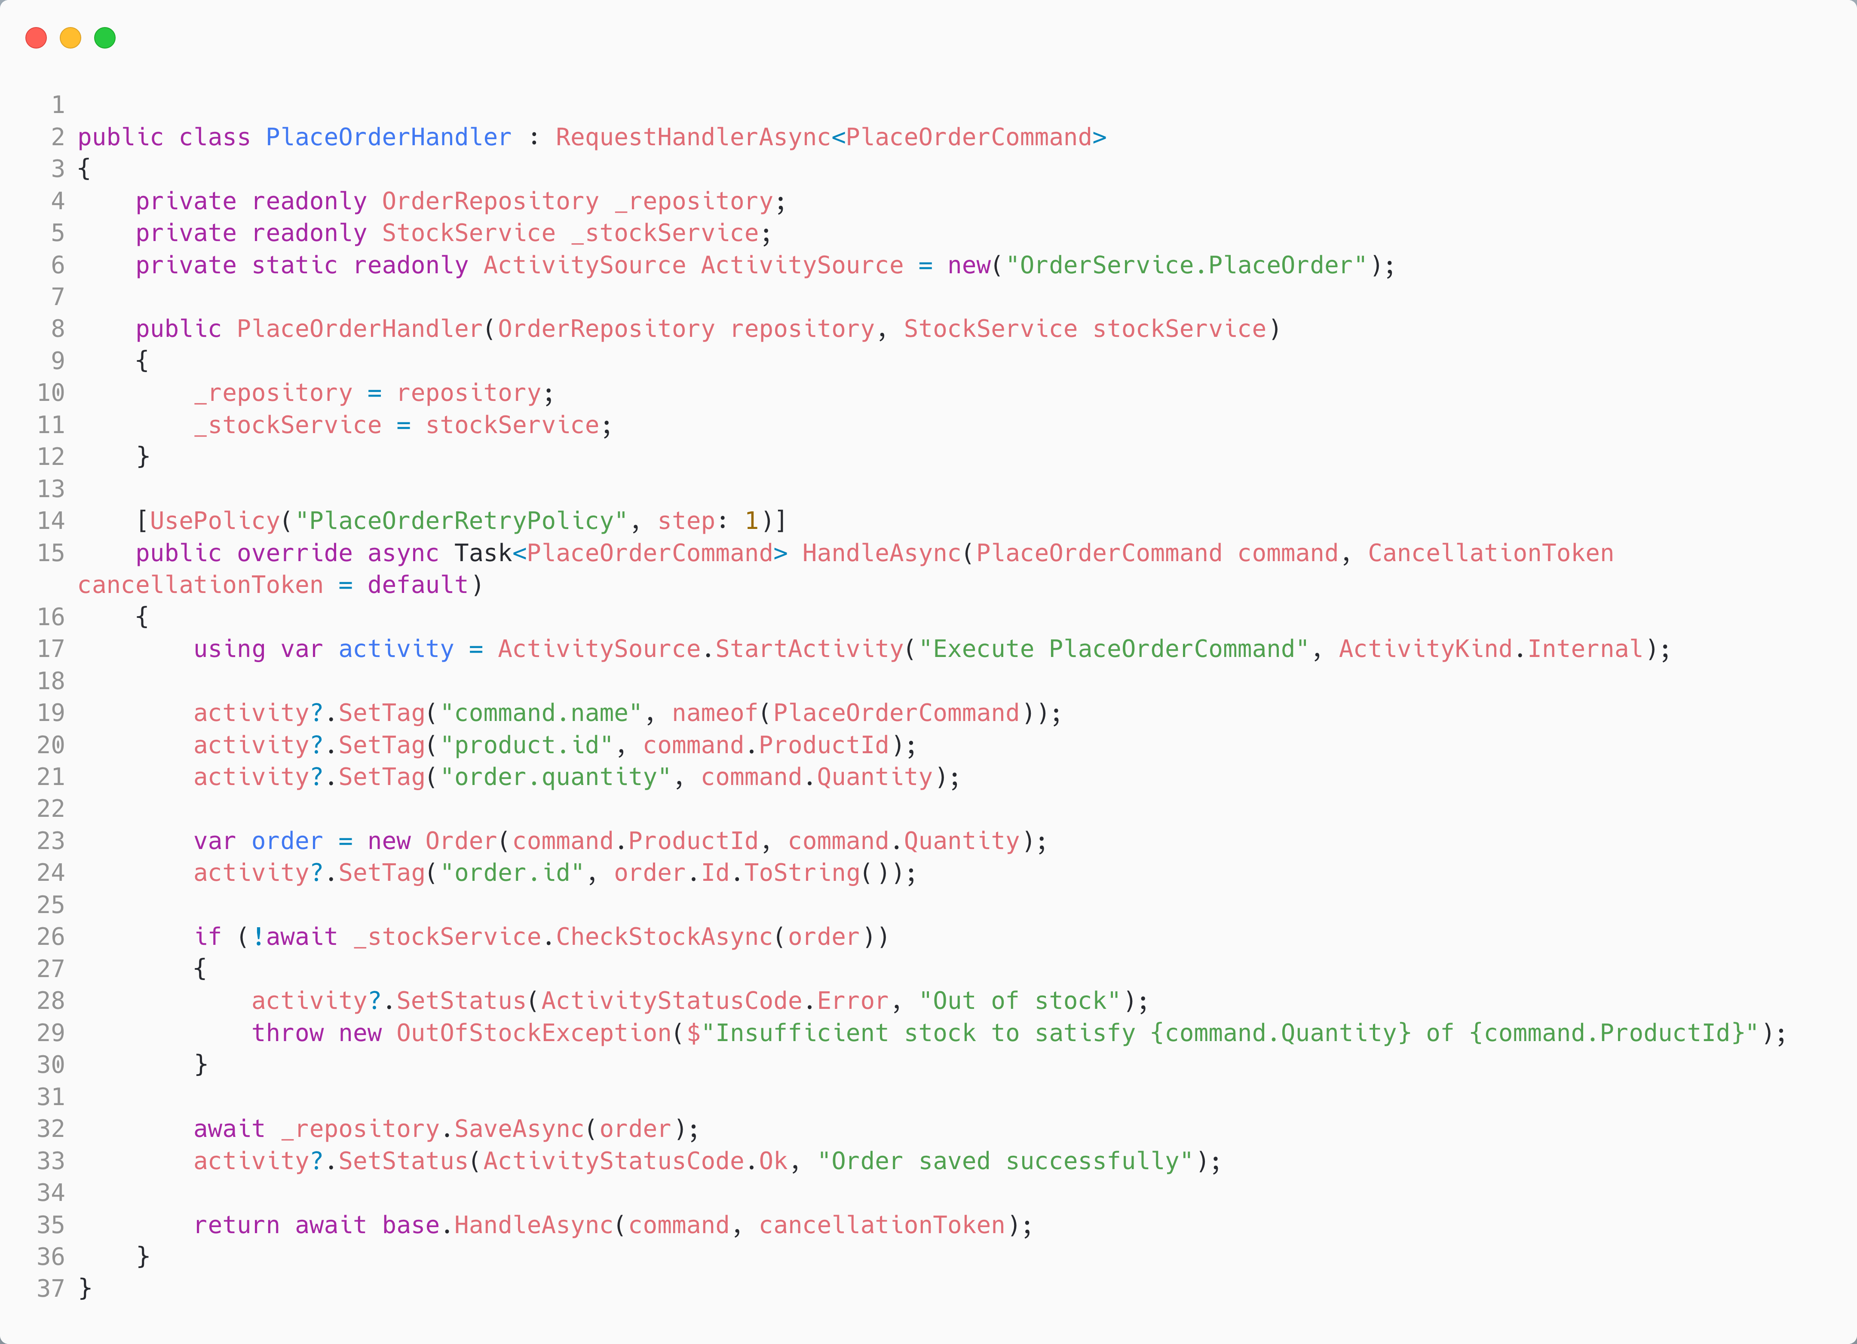
We move the Polly policy into the middleware – in principle, we could do the same with the telemetry, thus simplifying our handler further.

Slide 29
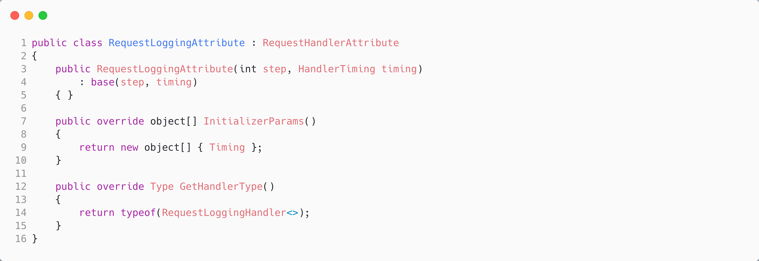
Brighter: Implementing a Pipeline
We use an attribute to allow the middleware to be declared against the handler it intercepts. Alternative strategies include a fluent builder pattern.
Notes:
Create your own Attribute class, derived from RequestHandlerAttribute.

Slide 30
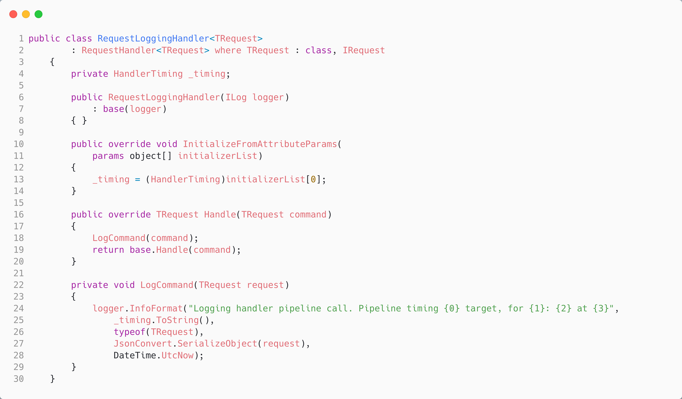
Brighter: Implementing a Pipeline
Note how the call to the next handler is explicit, allowing us to wrap it in a try…catch {} block or perform actions after with a try…finally{} block, etc.
Notes:
Create your handler, initialize from attribute if required

Slide 31
Commands vs. Events

Slide 32
Commands vs. Events
We will discuss commands and events in the context of your app for now. To be explicit, we are not considering messages flowing between apps in a distributed system.
Notes:
Commands: imperative, single target
Events: declarative, multiple listeners

Slide 33
Commands vs. Events
A command mutates the state of resources or activities owned by your application.
A command scopes to a consistency boundary.
After the command has executed, the resources and activities impacted must be in a consistent state.
A change may impact more than one object.
In DDD, an aggregate is a consistency boundary where every object in the boundary can be reached from a graph with a root object; this allows us to lock the root.
Notes:
Commands: imperative, single target
Events: declarative, multiple listeners

Slide 34
Commands vs. Events
A domain event notifies other consistency boundaries that an aggregate has been updated.
An event allows eventual consistency.
An event is treated like a command or query—we raise it, and it, in turn, we catch it at a port and execute the domain model, typically modifying another aggregate.
We may have zero or more handlers for any given event.
It is typical to raise the event in parallel to avoid blocking the command thread. We may also aggregate multiple domain events that occur during changes to the aggregate and raise them as a single event.
Notes:
Commands: imperative, single target
Events: declarative, multiple listeners

Slide 35
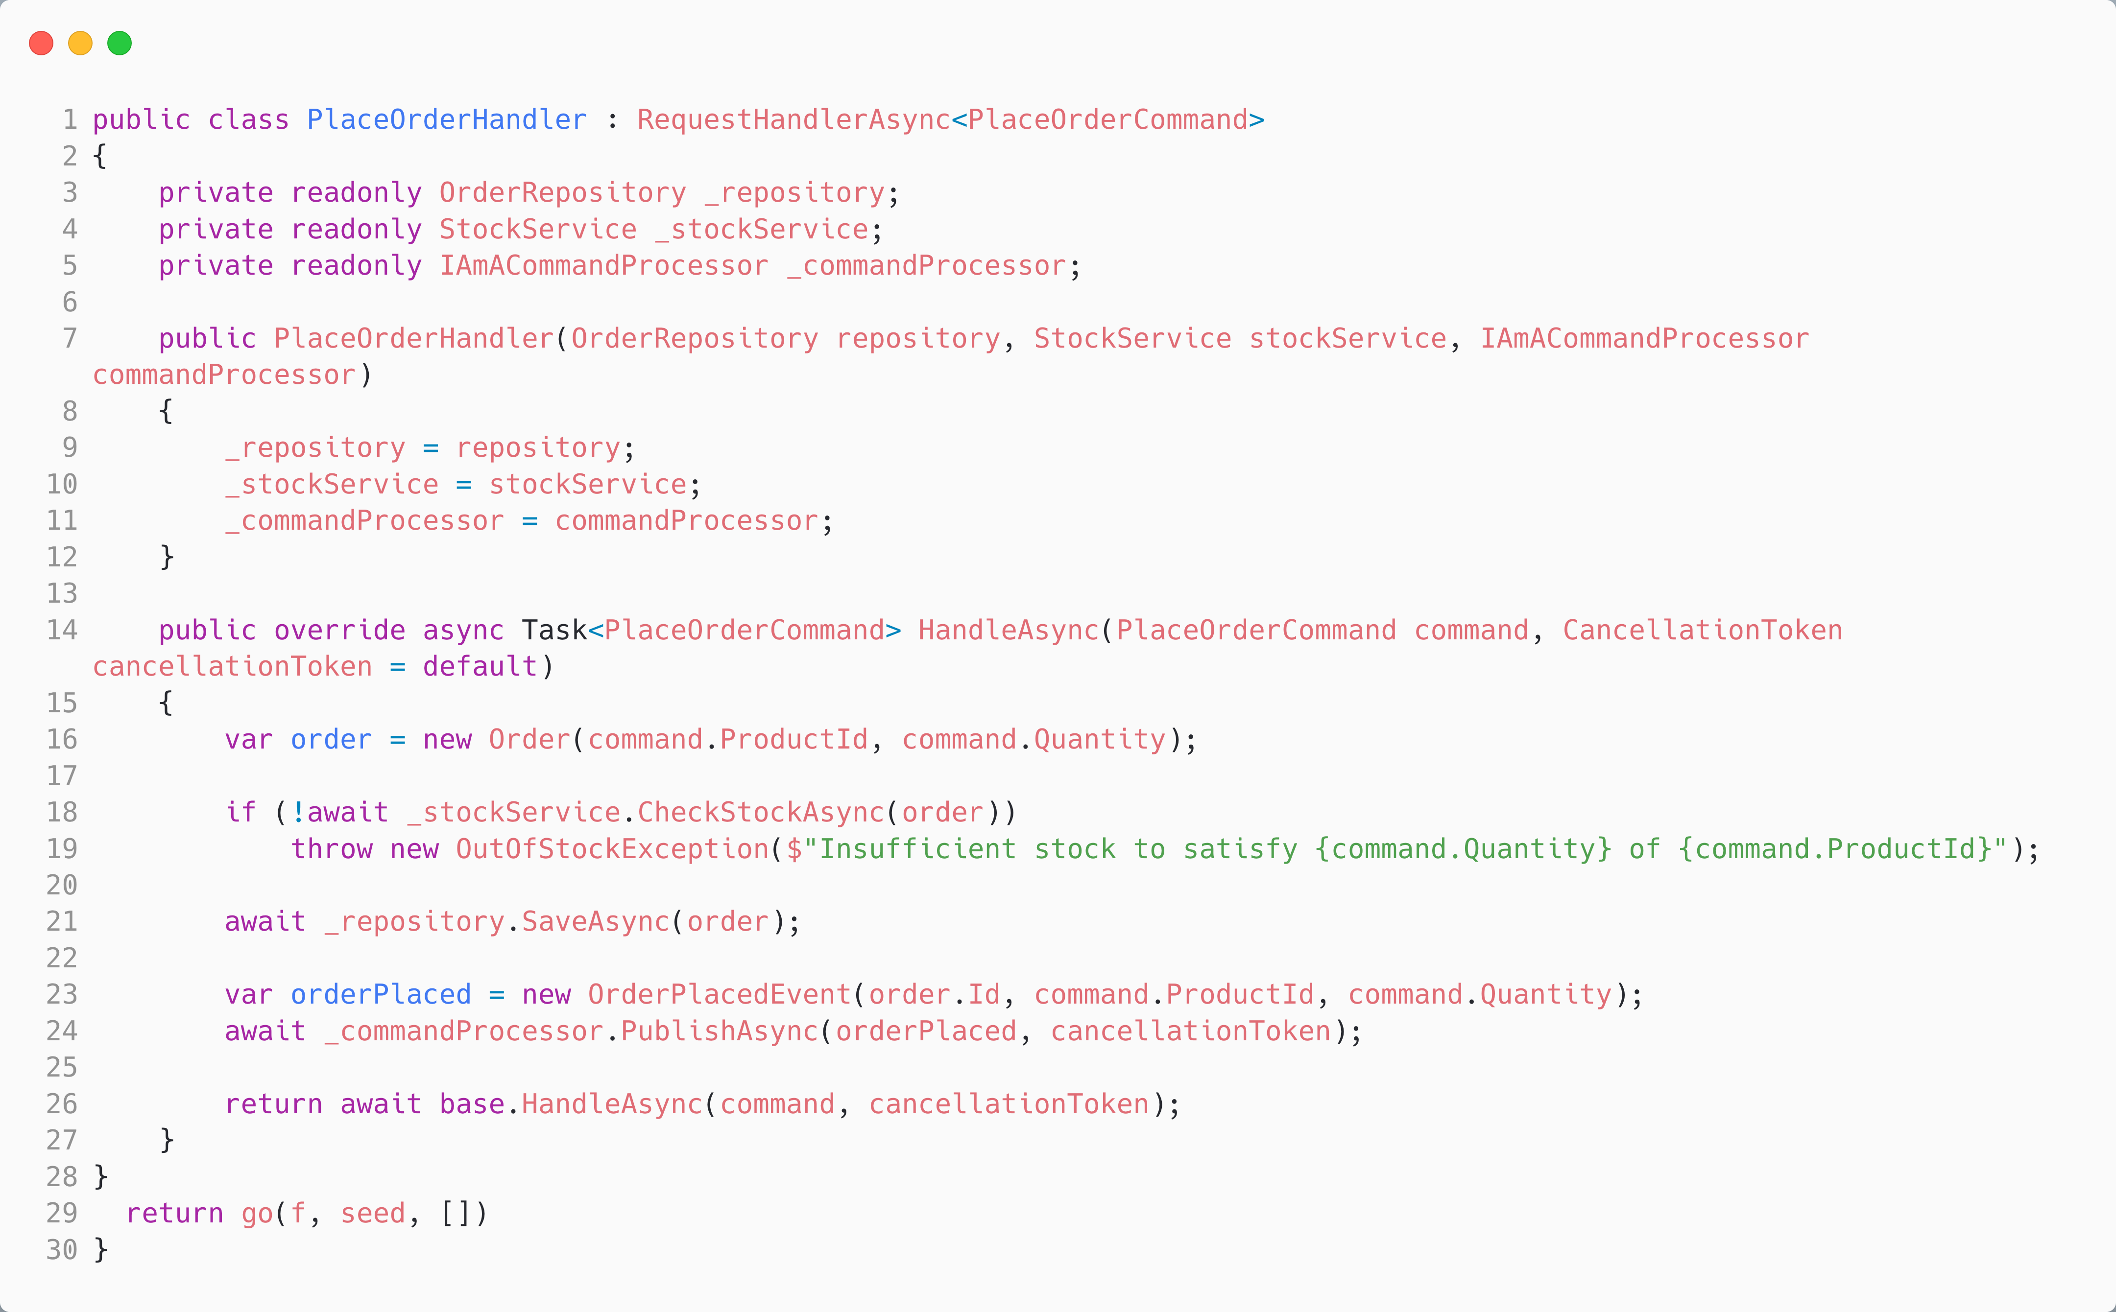
We raise a domain event after saving the order to notify other aggregates of what has happened.

Slide 36
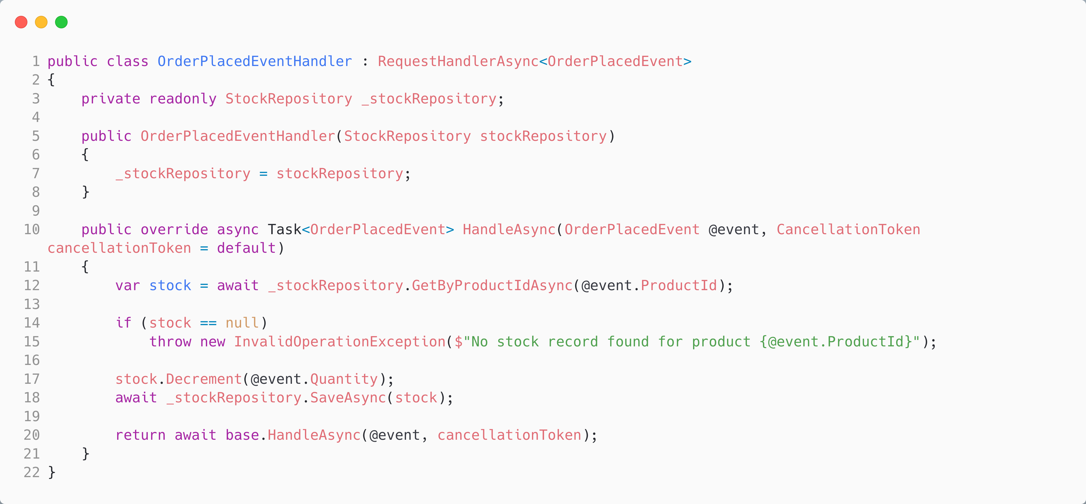
We handle the domain event to update our stock aggregate based on the occurrence.
We may worry about what happens if this event does not fire, but we have placed the order. Likely, we will raise out-of-stock in the warehouse, but next we will see how durable execution by a queue helps.

Slide 37
Guaranteed, At Least Once

Slide 38
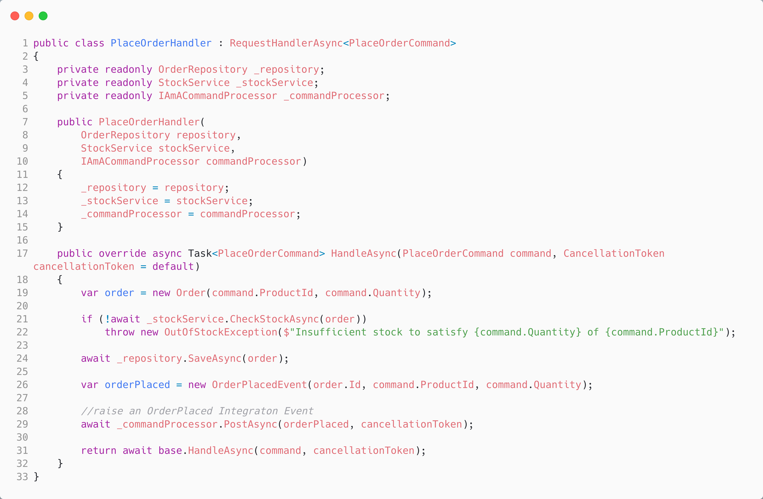
Instead of publishing the event locally, we post it to a broker, which in turn distributes it to its subscribers.

Slide 39
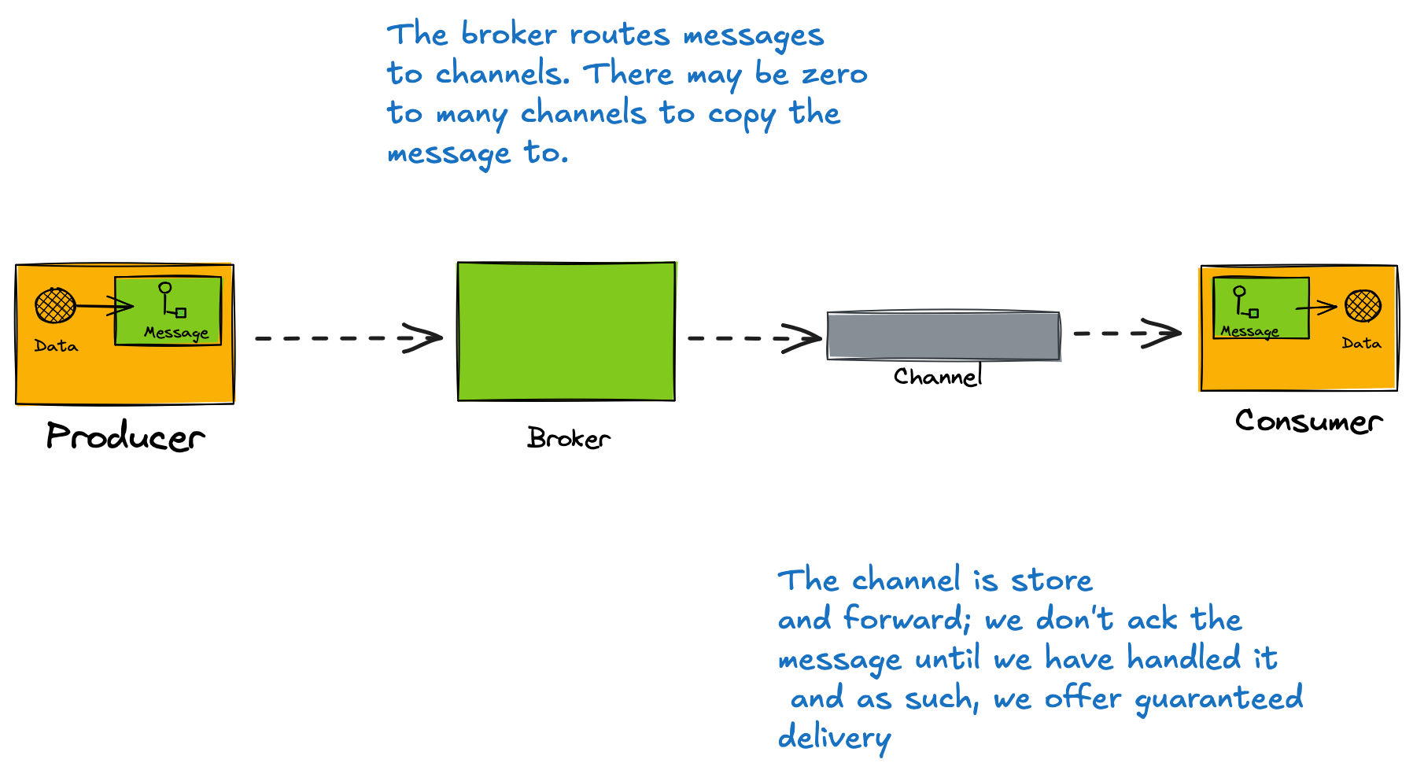
Guaranteed Delivery

Slide 40
Message Mappers and Transformations
To produce a message, from our request, we need some way to translate our request into a message
A given messaging transport has a protocol that describes how to write a message.
If we want to support multiple transports, one route is to convert the request into a neutral message format and translate that in each transport.
We use a message mapper for this.
Again, we can create a middleware pipeline for common transformations such as encryption, compression, and claim check, allowing these to be declarative.
Notes:
Translates transport format → domain object
public class PlaceOrderMessageMapper : IAmAMessageMapper<PlaceOrderCommand> { public Message MapToMessage(PlaceOrderCommand command) { return new Message(header, body); } public PlaceOrderCommand MapToRequest(Message message) { return JsonConvert.DeserializeObject<PlaceOrderCommand>(message.Body.Value); } }

Slide 41
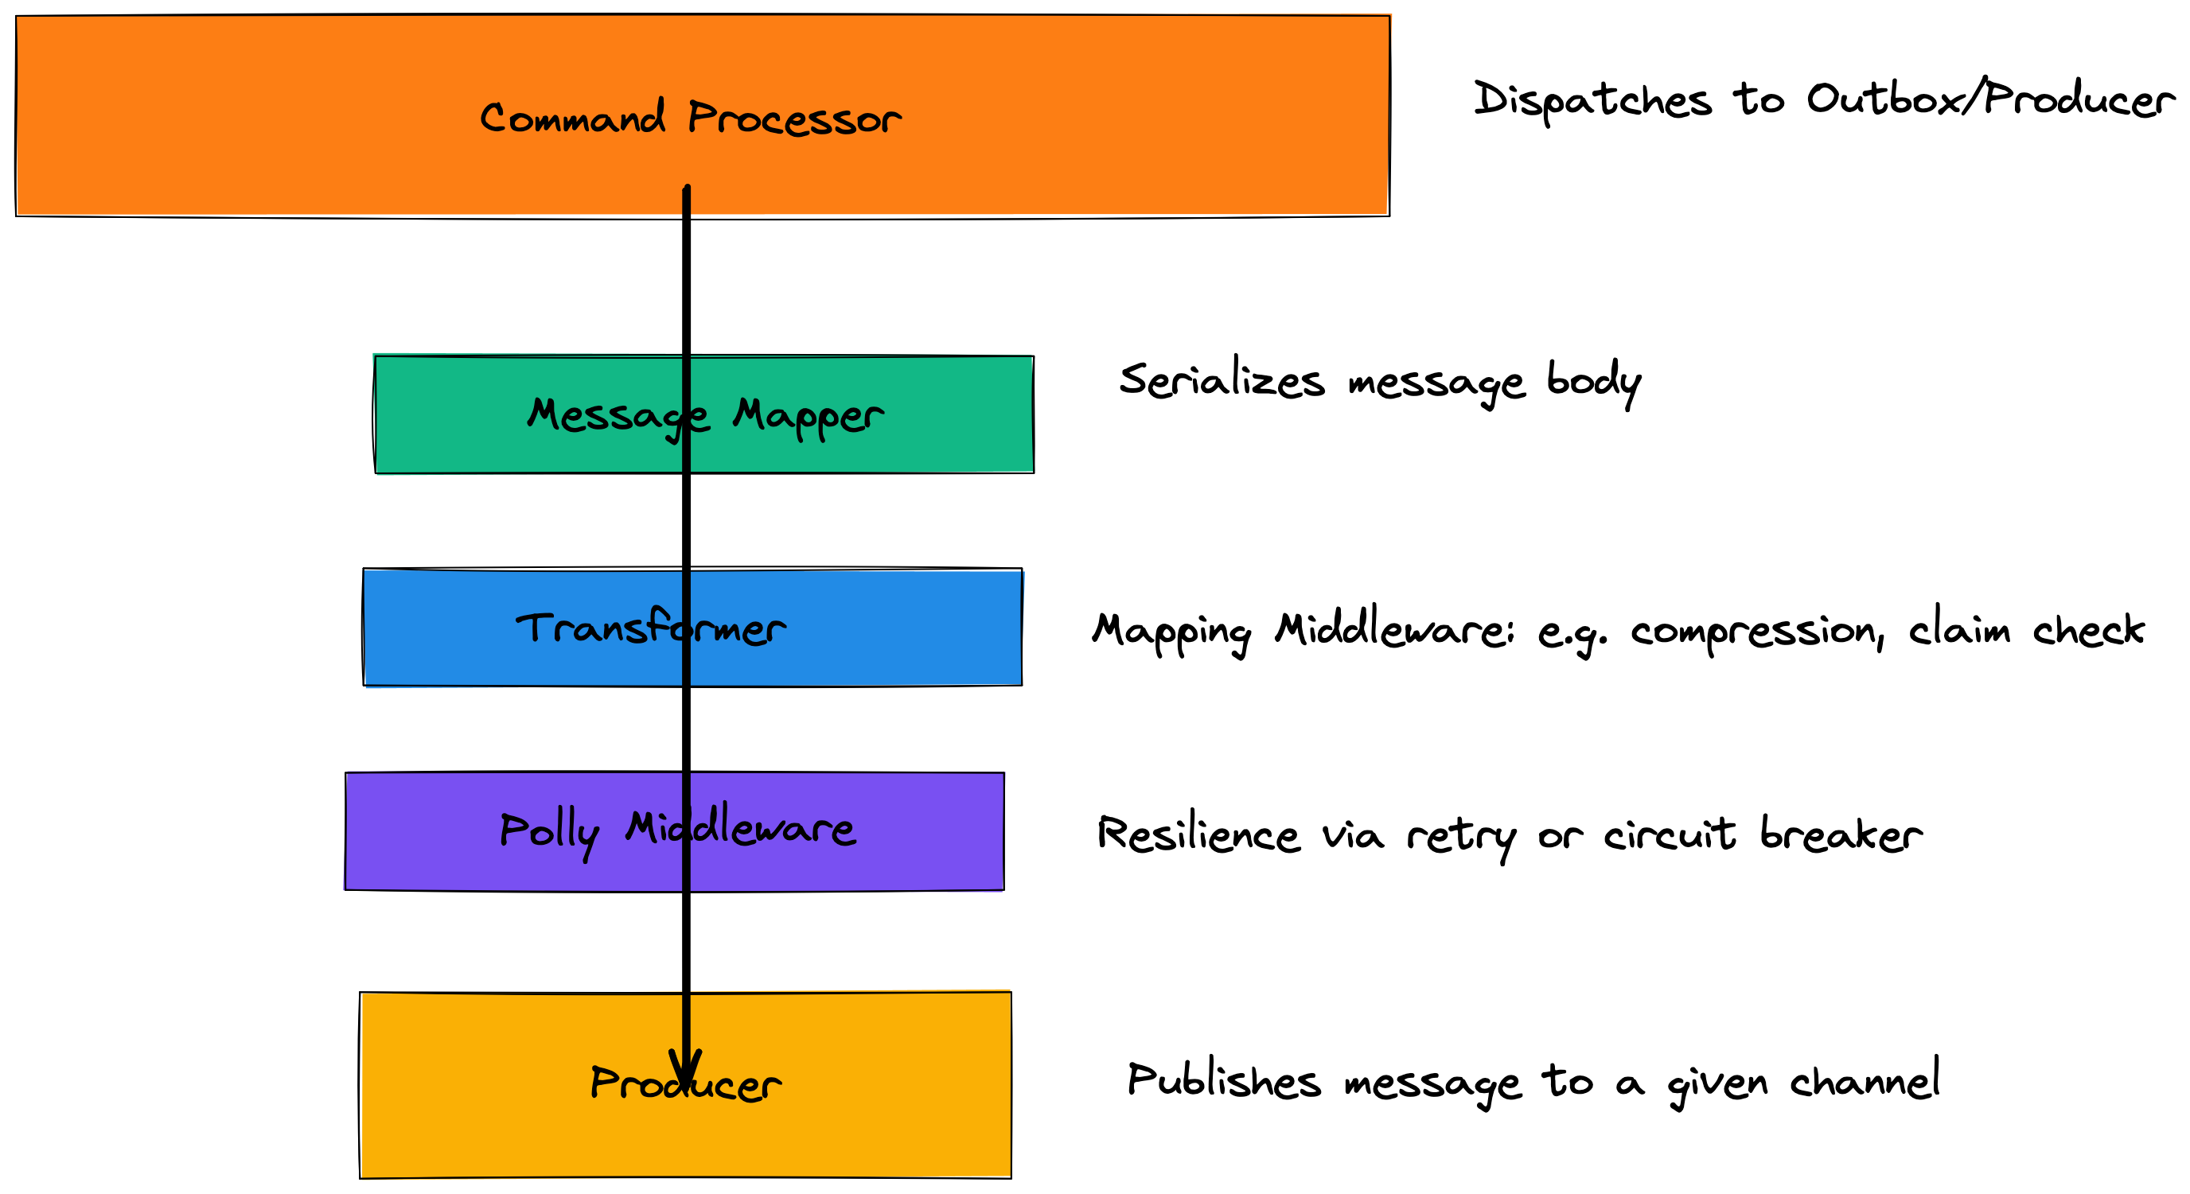

Slide 42
But this is not transactional – how do we guarantee the message will be sent if the order is placed?

Slide 43
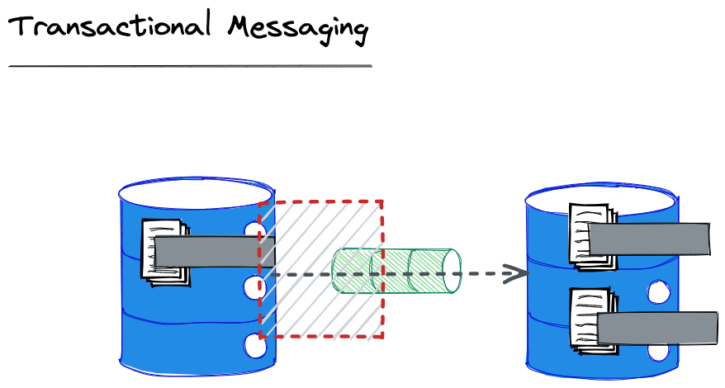
We must ensure that the message is enqueued using a transaction with the entity change; otherwise, the other entity will become inconsistent because no message was sent!

Slide 44
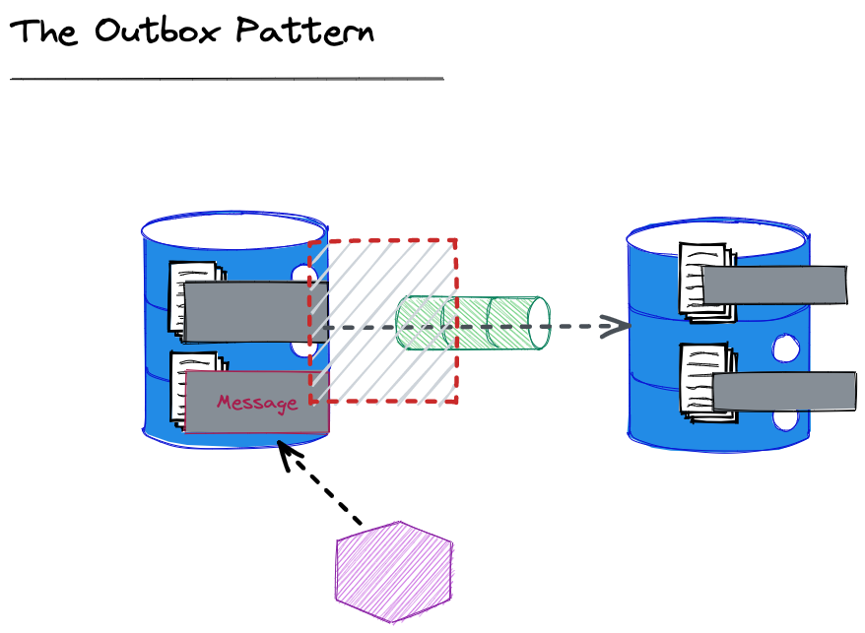
We can also send the message written immediately from the application to reduce latency (caused by the polling interval for the worker).
We are unable to create a transaction between Db and queue
We create an Outbox table and write the message we intend to send to that, in a transaction with the write with the changed/added entity
A worker looks for messages that have not been marked as sent, and sends them. It will retry until sent.
Notes:
This slide isn’t about Pat’s paper, it’s a pattern to solve the conundrum of enqueuing the message in the same transaction as the entity posed by Pat, in the absence of a transaction across queue and database.

Slide 45
We can’t know if our failure to receive an ack from the broker that a message was sent means it actually was not sent.
For this reason although we offer guaranteed delivery it is at least once, because we must resend until we get an ack.

Slide 46
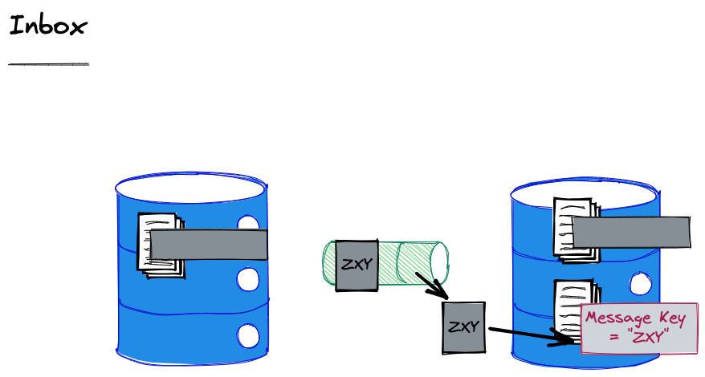
To ensure that we do not process a message twice, we record the ids of the messages that we have seen and discard duplicates.
Notes:
Defining Idempotence of Substantive Behavior
The processing of a message is idempotent if a subsequent execution of the processing does not perform a substantive change to the entity. This is an amorphous d efinition which leaves open to the application the specification of what is and what is not substantive. If a message does not change the invoked entity but only reads information, its processing is idempotent. We consider this to be true even if a log record describing the read is written. The log record is not substantive to the behaviour of the entity. The definition of what is and what is not substantive is application specific.

Slide 47
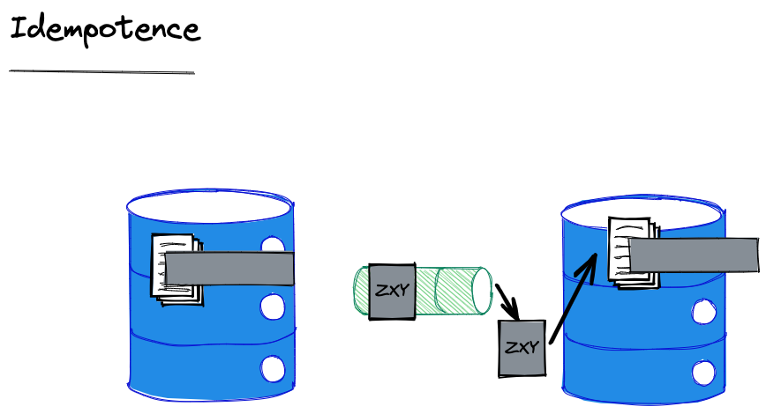
The alternative to an Inbox is idempotence. We say that a message is idempotent if reprocessing it does not carry substantive side effects.
Notes:
Substantive here is for the application to determine and is deliberately loose. But for example, writing a log would not be considered substantive in most cases.

Slide 48
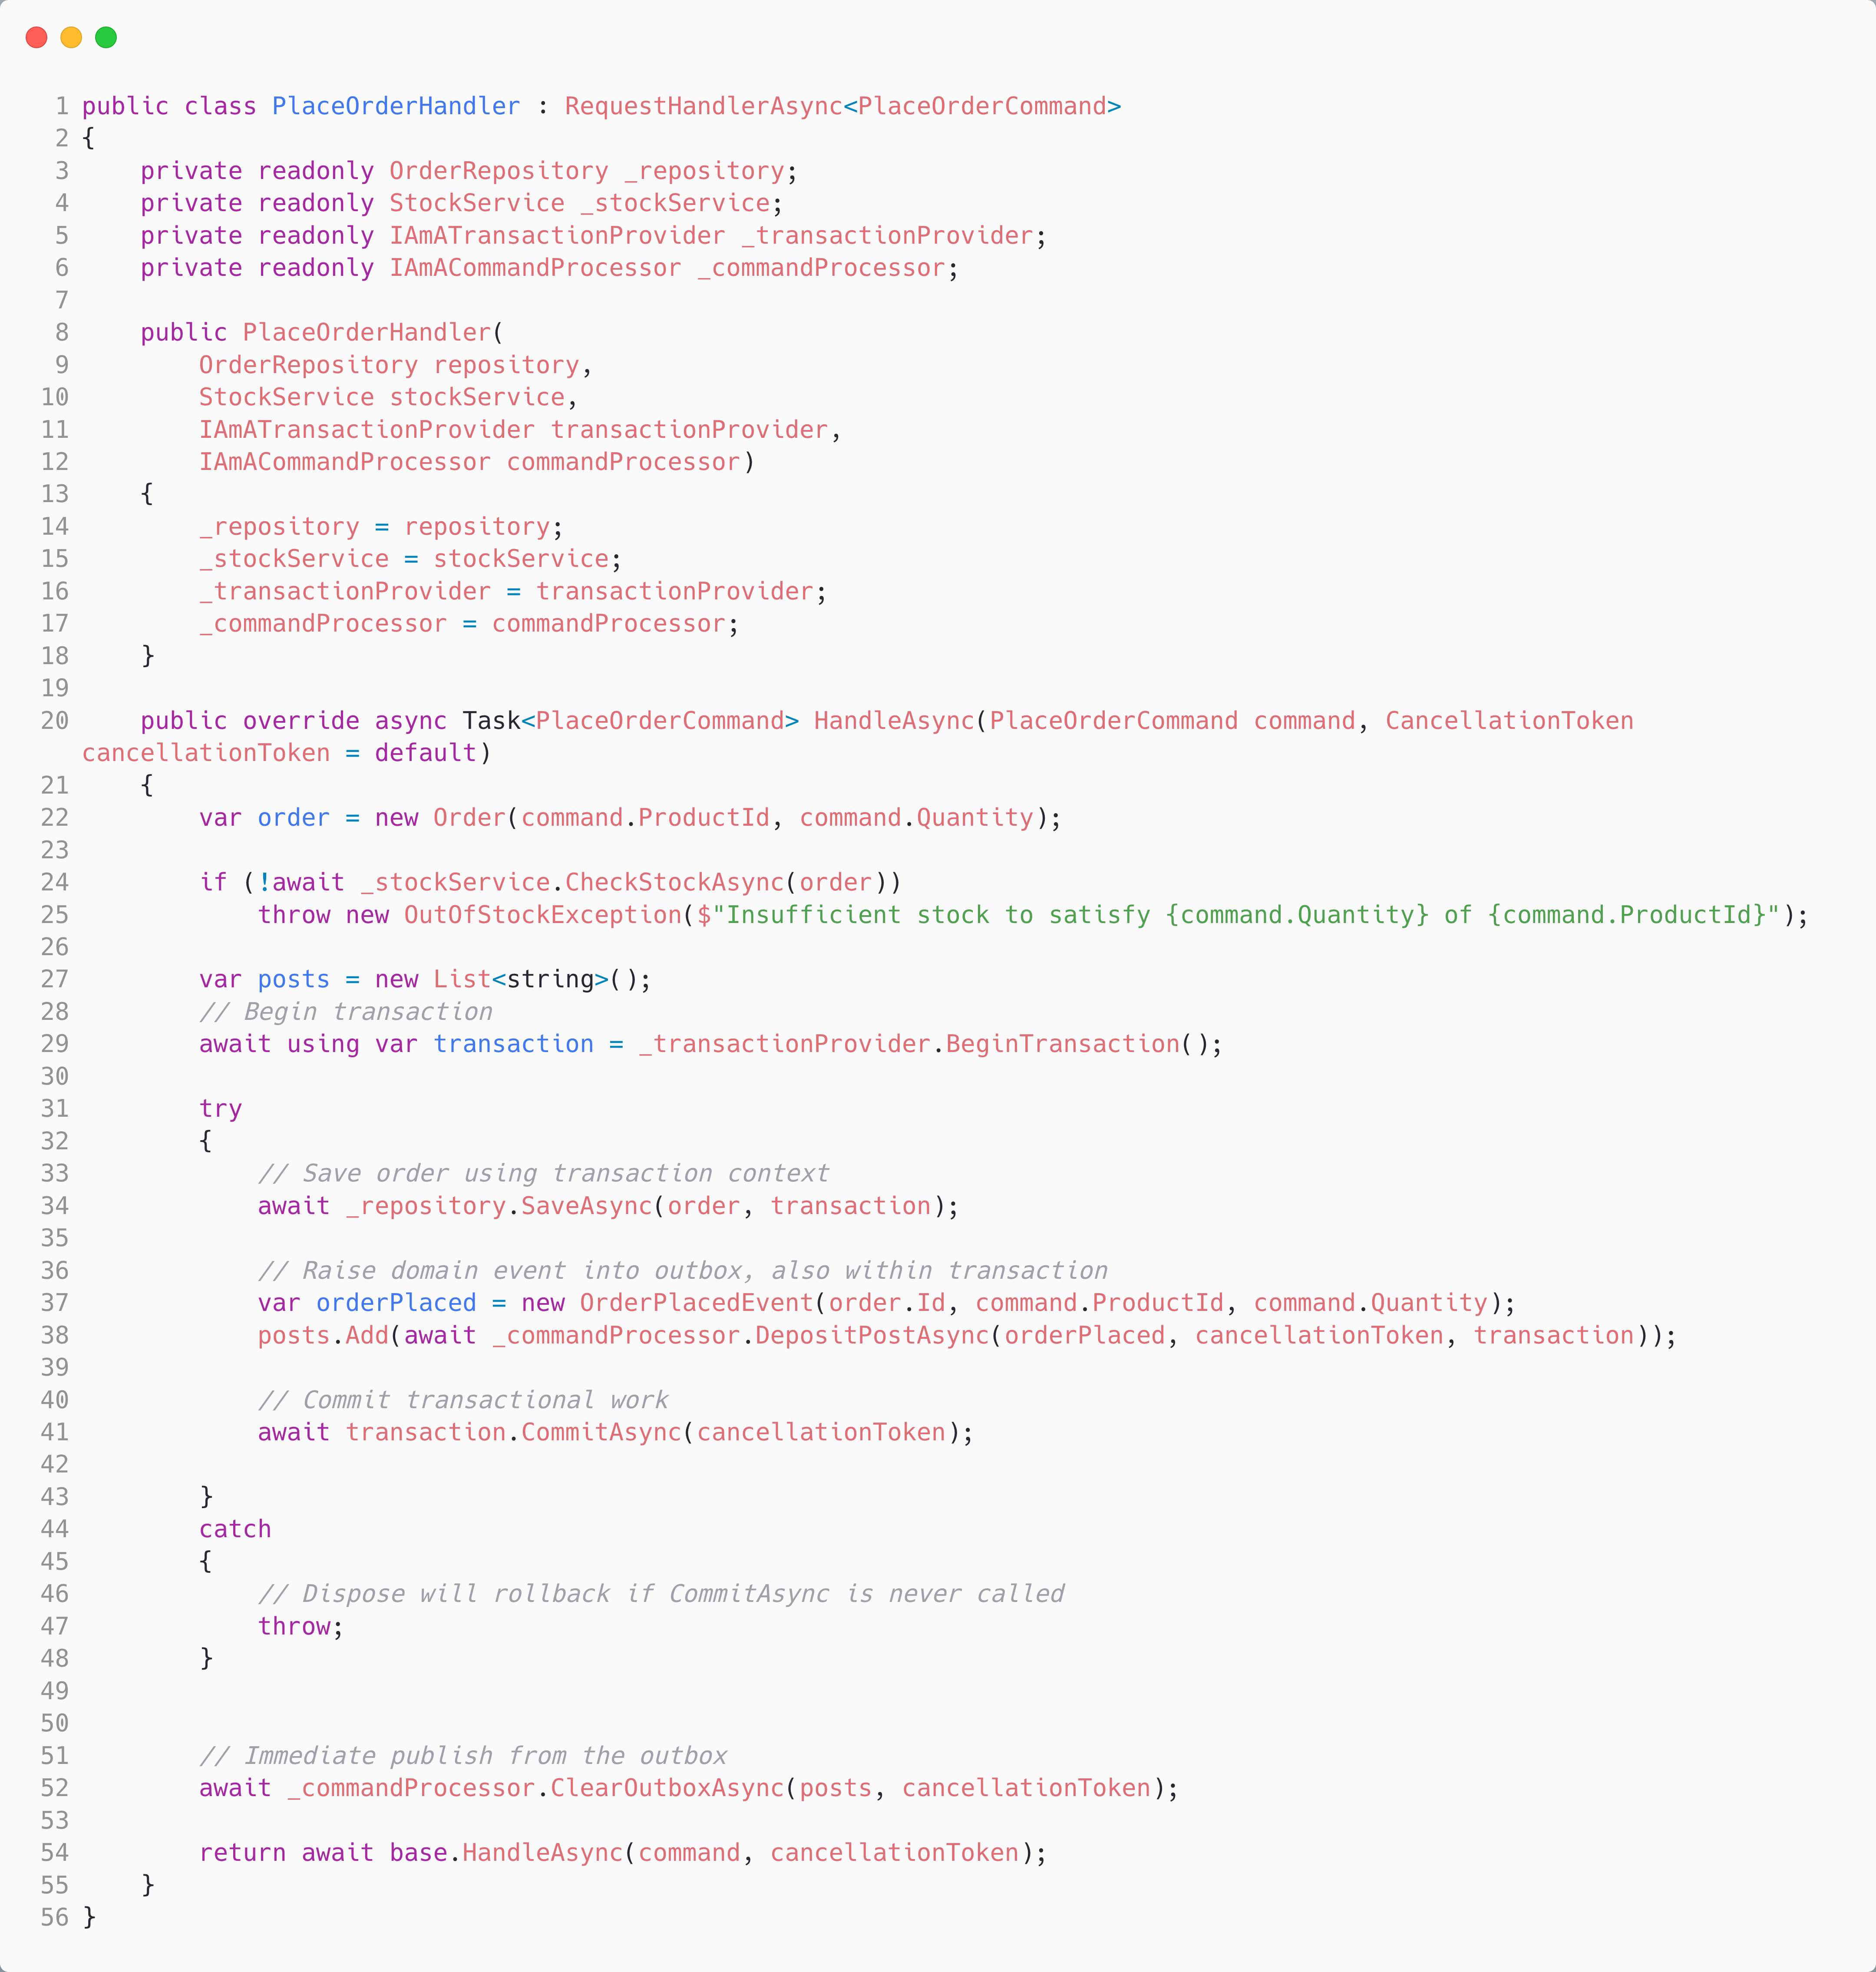
Within the transaction, we write the message to our Outbox
The Sweeper will pick this up, but we can immediately send to reduce latency
Notes:
- Avoid duplicate delivery with DB + message broker
// Save to outbox and domain state in one transaction using var tx = _db.BeginTransaction(); repository.Save(order); outbox.Save(new OrderPlacedEvent(...)); tx.Commit();

Slide 49
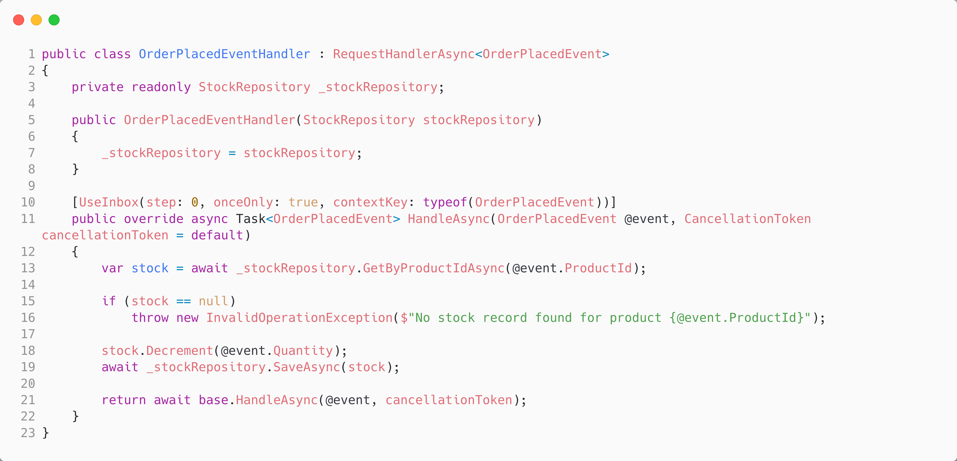
The Inbox lets us deduplicate incoming messages.

Slide 50
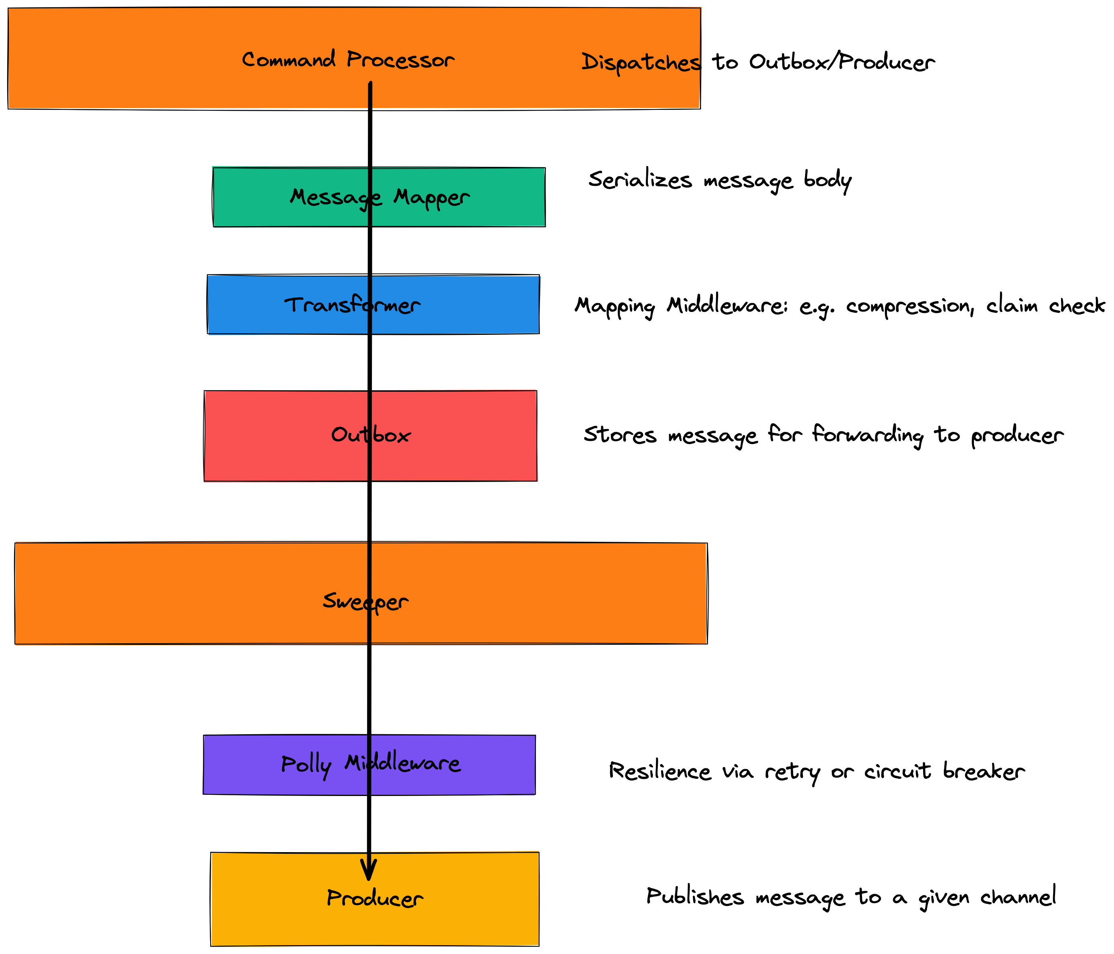

Slide 51
Why Not Do This Yourself?
The code to produce a message is often simple – connect to the broker, create a transport message, populate, done.
However, this won’t provide us with transactional messaging; for that, we need an Outbox.
To deal with duplicates, we will need an Inbox
To handle common transformations related to security or size, we will need to write code to handle those edge cases.
For resilience, we will need to wrap it in Polly, or an equivalent.
It is even more work, if we need to support multiple transports.

Slide 52
Message Pump

Slide 53
Messages as Commands or Events
Ideally we want to turn the event, or command, that we send over a message queue, back into a command or event.
This allows us to use our existing dispatcher to route the command or event to a handler – in effect, the distributed nature of the command or event becomes invisible.
Our middleware can execute if we can run our dispatcher pipeline. This is helpful if we encrypted, compressed, used a claim check, etc. as it allows us to reverse this.
How do we translate messages back from their transport format and dispatch them?
Notes:
Commands: imperative, single target
Events: declarative, multiple listeners

Slide 54
Dead Letter Channel
Error Log
Error Log
Invalid Message Channel
Failure to understand
Unexpected
Unrecoverable
Exception
Failure to deliver
Get Message
Translate Message
Dispatch Message
Handle Message
Requeue to Limit
Recoverable
Exception
Notes:
# The Message Pump #
The Message Pump is the name given to the code that takes a message from a channel and delivers it to application code. The pump runs in a loop, until cancelled.
The loop takes messages from the channel, and then translates the data in the message body into a type that can be understood by the application code.
The pump then looks up application code registered to handle messages of that type, and sends the translated message to that application code to be handled.
Control passes from the Message Endpoint to application code, which executes in response to receipt of the message and handles it.
When errors occur in the middleware, whilst attempting to deliver the message to the endpoint, the message can be moved to a Dead-Letter Channel.
When errors occur translating a message, then the message can be moved to an Invalid Message Channel.
If errors occur dispatching a message to application code, it should be logged, and an exception thrown, as the application has been incorrectly configured. The message should not be acked and the application should be shut down, to avoid losing data.
If errors occur in the application code, and those errors are not recoverable, then the message should be acked to remove it from the channel, as replaying it would have the same consequences, and the error should be logged. Processing may be able to continue with subsequent messages.
If the message could be retried, because the condition causing the error is transient, then the message can be put back onto channel (usually with a delay) to retry. An upper limit on the number of retries is usually placed, to avoid poison pill messages. Ideally, messages that exceed the retry limit, should be handled the same way as an unrecoverable exception

Slide 55
Translate and Dispatch
Message Mapper Registry
Handler Registry
Lookup Mapper
Lookup Handler
Get Message
Translate Message
Dispatch Message
Handle Message
Notes:
A Messaging Mapper converts domain objects into a message as required by the messaging channel.
It also provides the reverse capability, create or update a domain objects based on an incoming messages.
Because of this mediator, the domain does not need to know about messaging formats and vice-versa
Typically, the endpoint allows registration of message mappers for channels, and uses a data type channel.
The application code that executes in response to a message it typically called a handler. Typically, handlers are subscribed to channels that the endpoint is configured to listen on.

Slide 56
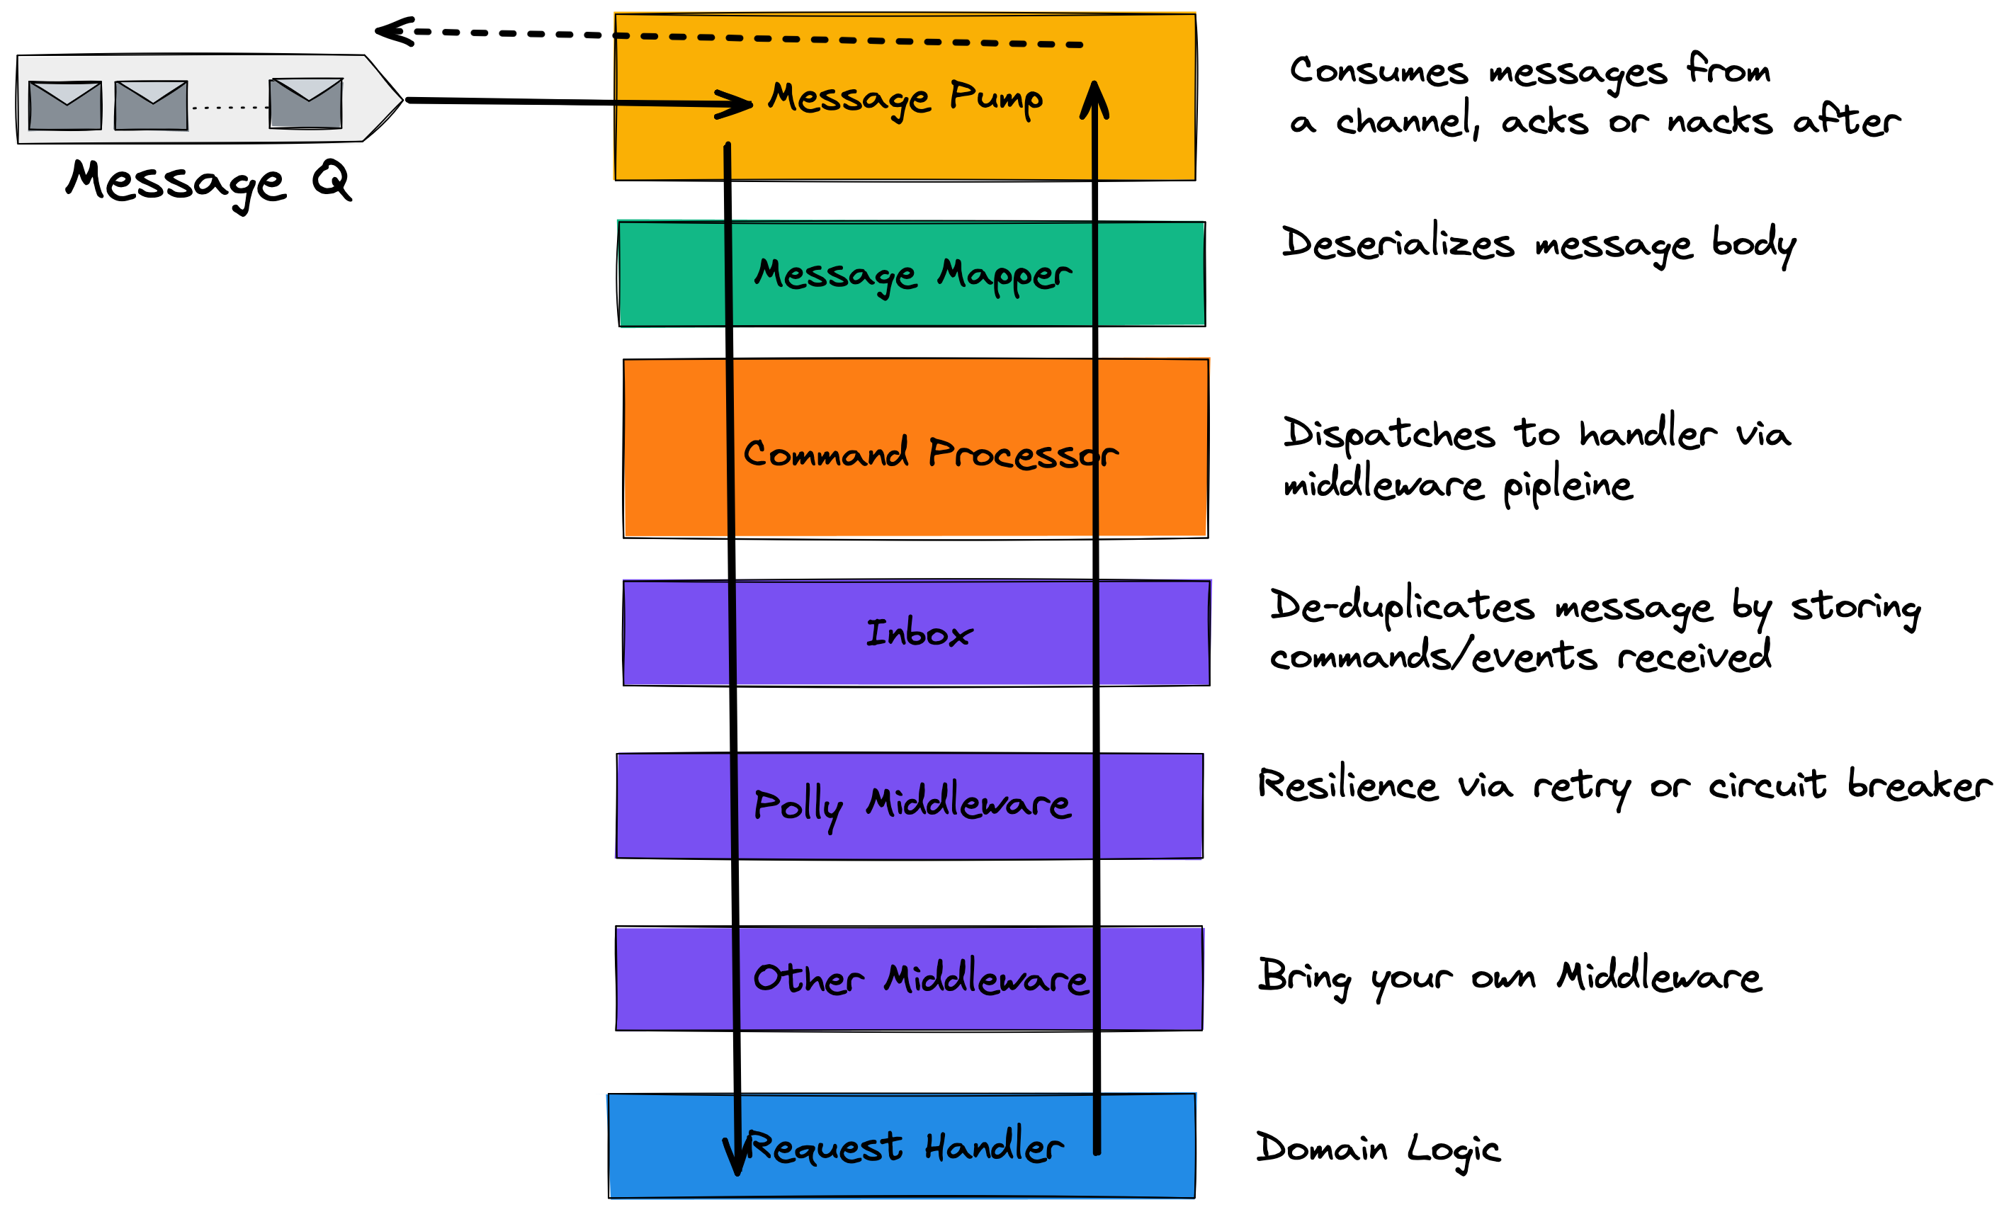

Slide 57
Durable Execution
Long-running processes must:
Survive restarts
Handle retries and failures
Resume after waiting (e.g., waiting for payment or a courier)
Durable execution = we persist activity state to indicate which steps in a sequence have been completed, when we are awaiting an event etc.

Slide 58
Handlers & Durable Execution
Long-running processes must:
Survive restarts
Provided we don’t ack until a message has been handled, we will not lose work. We should be transactional to avoid partial writes.
Requires Transactional Messaging
Handle retries and failures
Our middleware pipeline can use resiliency libraries like Polly
Resume after waiting (e.g., waiting for payment or a courier)
A correlation ID lets us tie together a request and its reaction, allowing us to wait between being signalled.

Slide 59
Further Durable Execution
Long-running processes must:
Survive restarts
Provided we don’t ack until a message has been handled, we will not lose work. We should be transactional to avoid partial writes.
Requires Transactional Messaging
Handle retries and failures
Our middleware pipeline can use resiliency libraries like Polly
Resume after waiting (e.g., waiting for payment or a courier)
A correlation ID lets us tie together a request and its reaction, allowing us to wait between being signalled.

Slide 60
Section 5: Reactor vs Proactor

Slide 61
Slide 22: The Reactor Pattern
- Event loop: sync, single-threaded
while (true) { var message = _channel.Receive(); // blocking _commandProcessor.Send(_mapper.MapToCommand(message)); }

Slide 62
Slide 23: The Proactor Pattern
- Async IO model: Task-based concurrency
while (await _channel.HasMessagesAsync()) { var message = await _channel.ReceiveAsync(); await _commandProcessor.SendAsync(_mapper.MapToCommand(message)); }

Slide 63
Slide 24: .NET and Concurrency Models
- Thread pool exhaustion risk
- Use async handlers or explicit threading

Slide 64
Slide 25: Explicit Threads for Resilience
- Background thread workers instead of thread pool
var worker = new Thread(() => messagePump.Run()); worker.IsBackground = true; worker.Start();

Slide 65
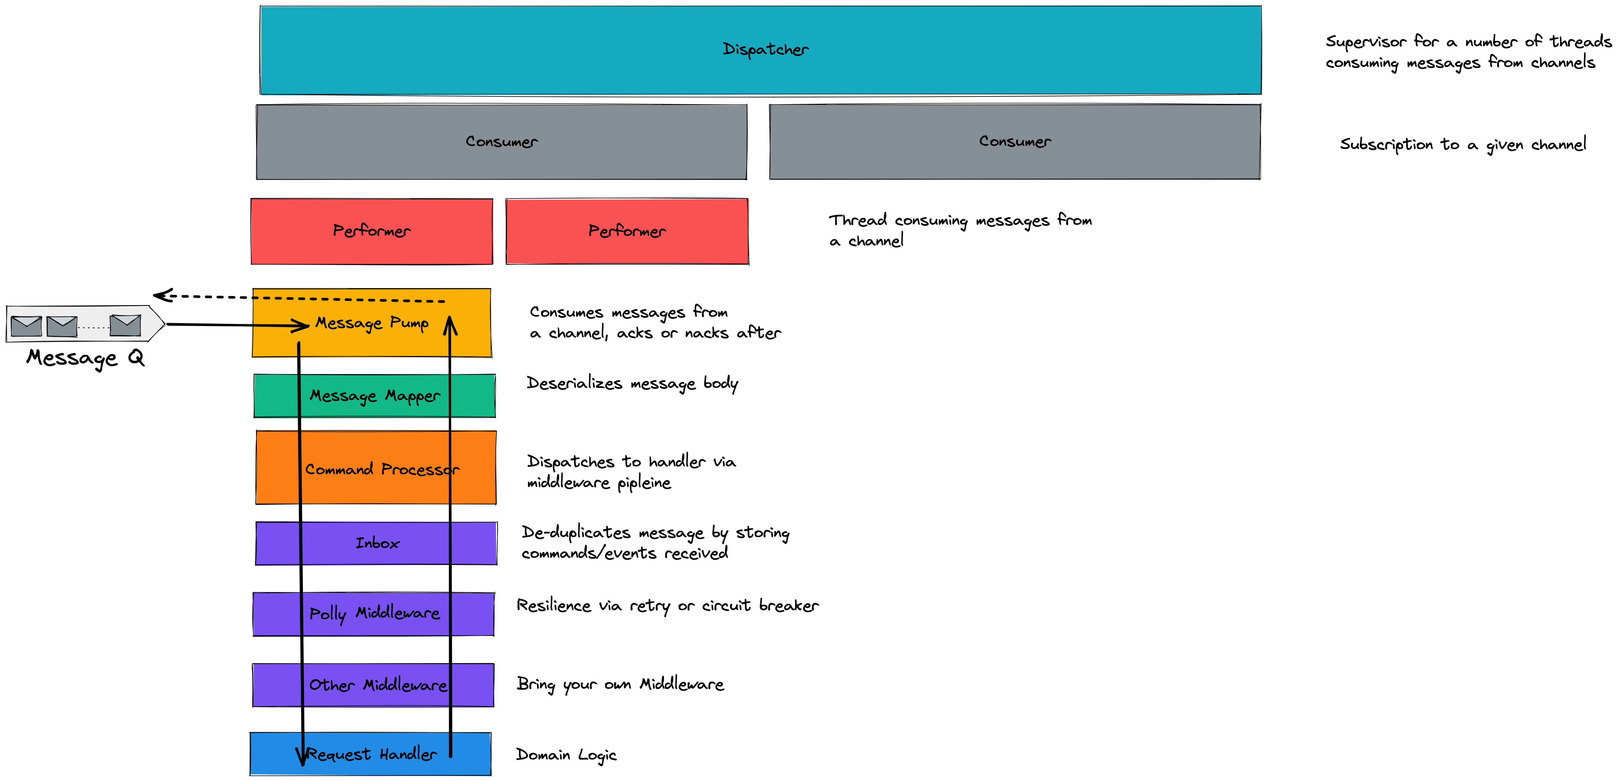

Slide 66
Wrap Up

Slide 67
The Cost of Ownership
The cost of software is in ownership, not authorship.
Order of magnitude difference
Less code, is lower ownership cost
Reuse lowers cost as it reduces the amount of code.
OSS reuse reduces your cost of ownership further (learning to use and possibly making PRs still count, but OSS spreads the cost of ownership across many).

Slide 68
Buying Experience
An OSS Framework offers years of experience solving a problem
Often your library starts out simply…
But then you hit issues around network errors…
And then you need to write an Outbox
And then someone wants to use a different transport or storage provider.

Slide 69
Thank You
- Slides on GitHub
- Blog and video series coming
- Questions?

